Slide 1
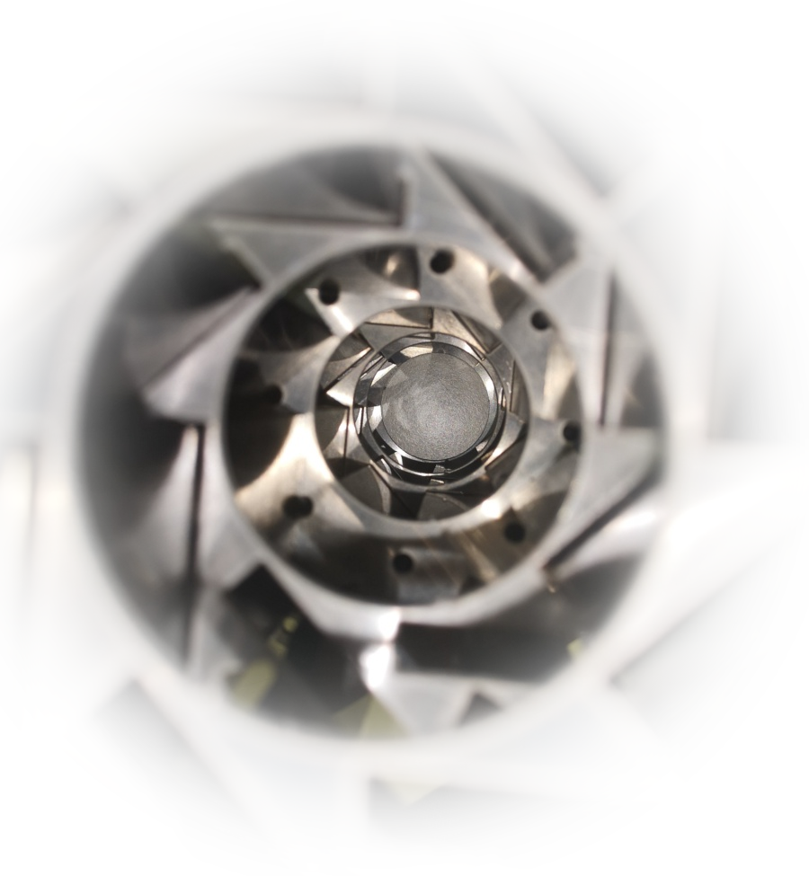
An ongoing campaign for the radiation testing of structural and thermal materials at CERN EP-DT
Nicola Pacifico

Slide 2
Motivation
HL-LHC will face increased radiation levels at all experiments, by a factor 5-10
Many materials (adhesives, insulations, etc. are not qualified to these radiation levels)
Radiation damage mechanisms
Ionization
Displacement damage
Conductors (or semiconductors)
Typically not recoverable at room temperature
Totally recoverable
Macroscopic effects on structural properties are usually noticeable at relatively high fluences (~>10¹⁸ n/cm²)
Insulators
Not recoverable
In polymers: degradation of polymeric chains
Charging up of passivations
Electrical properties in semiconductors affected at doping concentration levels (~>10¹⁰ n/cm²)

Slide 3
Radiation damage in polymers
Radiation causes polymers chain to break
Depending from the polymer characteristics, the chain can either:
Shorten:
The polymer softens and loses cohesion (depolymerization), typical for Teflon, polycarbonate etc.
Recombine into longer chains (cross-link):
The polymer becomes rigid and brittle (e.g. rubbers)

Slide 4
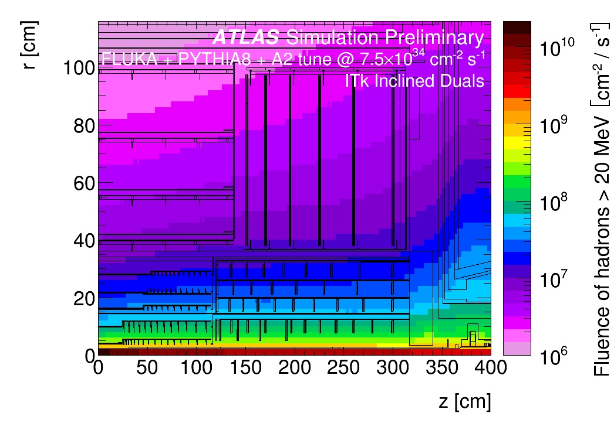
The HL-LHC environment

Slide 5
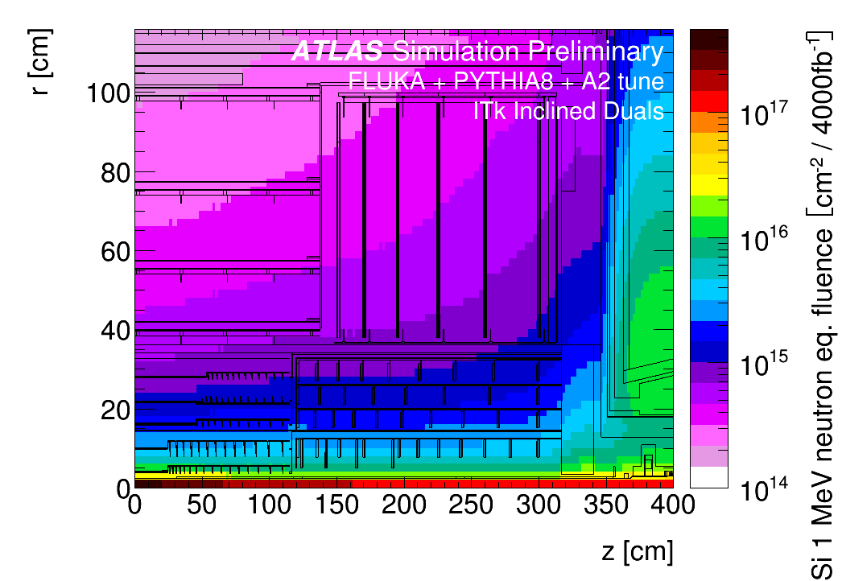
The HL-LHC environment

Slide 6
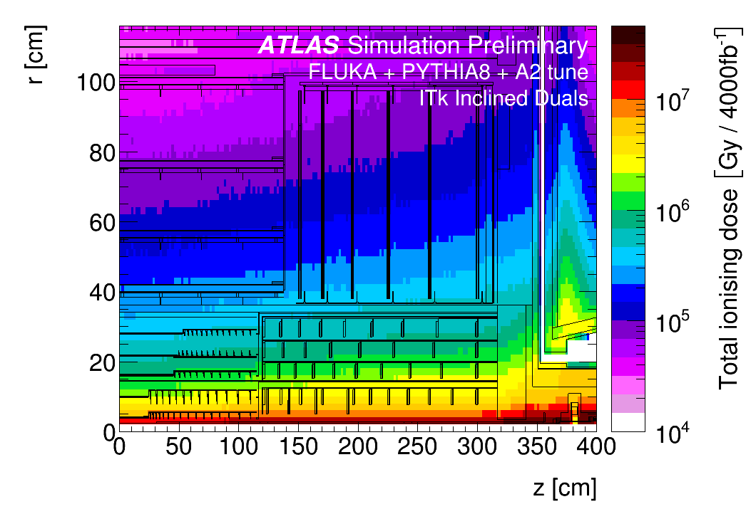
The HL-LHC environment

Slide 7
Aging/irradiation tests: some considerations
Most reliable scenario: irradiation in “free spots” in experimental caverns
Pros: - radiation field reflects the “real” one
- comes for “free”
Cons: - long irradiation times (years) – planning often doesn’t allow this - environment can be tricky (standard atmosphere, no humidity control)
- samples can be accessed only during shutdowns
Most realistic scenario: irradiation in dedicated high dose rate facilities
Pros: - short irradiation turn-over times (suitable e.g. for R&D) possibility
Cons: - accelerated aging can be not fully representative of “real” aging
(there is evidence of dose rate dependence of degradation on some materials) - necessary to control temperature and ozone formation
- can be expensive

Slide 8
Specialized irradiation facilities
(examples, mentioned for completeness, but not pertinent to this talk)
Type | Field characteristics | Application
> GeV protons | High dose rate, small sample size (~cm^2) or scanning table (with lower effective dose rate). Close approximation of “real” usage conditions in HEP. Significant sample activation. | Small material samples, active and passive electronics, small prototypes (up to 10x10 cm2).
~100 MeV Pions | Medium dose rate, small sample size or scanning table. Close approximation of “real” usage conditions in HEP. Significant sample activation, limited availability (no specialized facility, mostly piggybacking on HEP experiments) | Small material samples, active and passive electronics, small prototypes (up to 10x10 cm2).
Synchrotron light sources | Extremely high instantaneous dose rate, on small volumes. No activation. Suitable for specialized detector irradiation studies. | Small detectors, active and passive electronics. Highly localized irradiation (beam size ~10 um)

Slide 9
Standard irradiation facilities
Type | Field characteristics | Application
~20-70 MeV protons (cyclotrons, synchrotrons) | High dose rate, small sample size (~cm^2) or scanning table (with lower effective dose rate). Significant bragg peak – dose tuning difficult for different samples. Combination of displacement and ionization damage | Active and passive electronics, small prototypes (up to 10x10 cm2).
~10 MeV neutrons | High dose rate, medium sample size, good irradiation uniformity, no direct ionizing energy loss. | Material samples, active and passive electronics, small prototypes (up to 10x10 cm2).
Gamma (60Co or 137Cs) | High instantaneous dose rate, on large volumes. No activation. Very good radiation uniformity. | Material samples, active and passive electronics.
~5-10 MeV electrons | Very high instantaneous dose rate, large areas can be scanned quickly, limited penetration depth. | Small (thin) samples, active and passive electronics
Comprehensive list of irradiation facilities at https://irradiation-facilities.web.cern.ch/

Slide 10
Choice of the irradiation facility
TANSTAAFL: “There ain’t no such thing as a free lunch” (R. A. Heinlein)
TANSTAAIIF: There ain’t no such thing as an “ideal” irradiation facility.
Field | Gamma | Protons * | Neutrons | Electrons
Large volume irradiation | Ok |  | Ok
Reasonable irradiation time | Ok | Ok | Ok | Ok
Representative radiation field |  | Ok
Lack of material activation | Ok |  |  | Ok
Irradiation depth uniformity | Ok |  | Ok
* Note: only 20-70 MeV proton sources are considered – the few (worldwide) GeV proton sources cannot handle a material characterization campaign.

Slide 11
What should I test for?
Generic R&D
Identify the characteristic(s) of the material of interest
Identify a test standard (ISO, ASTM, etc.) for the characterization of the chosen quantity.
Verify that the test samples are compatible with the irradiation (e.g. avoid thick samples, high Z support materials)
Targeted development – I want to use this material in my assembly
Do I know what am I testing?
Example 1: Does the material contain silver, or zinc, and I want to use it in a HL-LHC environment? => Significant activation Example 2: I have found a nice thermally conductive glue: it contains Boron Nitride. Boron has a high neutron cross section. => High absorption in the glue (higher doses), potential increase in temperature.
How will the material interact with the rest of the assembly?
Examples: CT mismatches, young modulus, hardness, etc.
Following the material characterization, the overall assembly should be irradiated and tested with a field as close as possible to the final one (e.g. a mixture of GeV protons and neutrons)

Slide 12
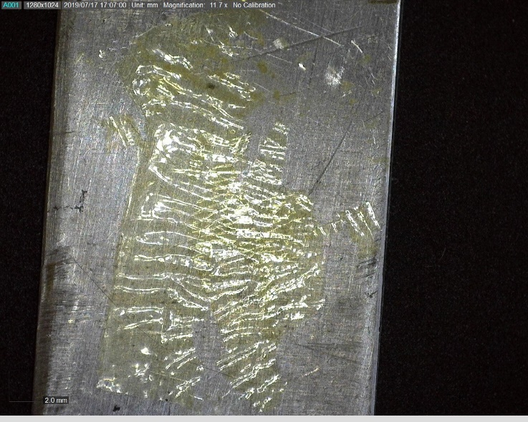
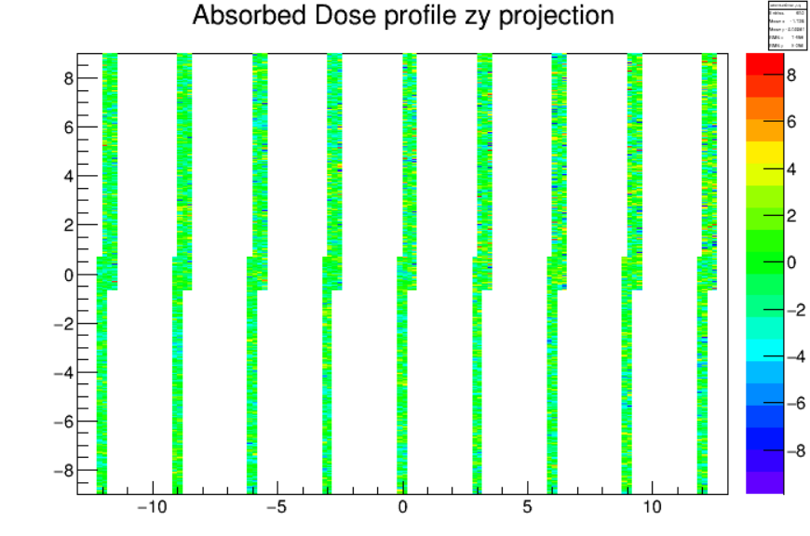
What can go wrong?
Temperature: High dose rate irradiation causes significant sample heating. Temperatures in excess of 100C can easily be reached without cooling
Solution: provide active cooling of the samples, monitor the temperature online.
Ozone: Irradiation in free air converts O2 to ozone, highly corrosive; possibility to chemically damage the samples Solution: ensure adequate ventilation, do not enclose the samples.
Self shielding: Upstream samples can shield a significant fraction of downstream radiation, resulting in significantly lower doses to downstream samples Simulate the attenuation of the samples in the known source geometry.

Slide 13
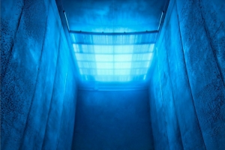
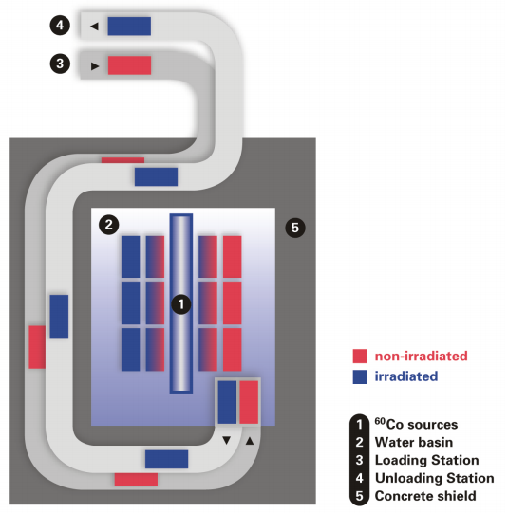
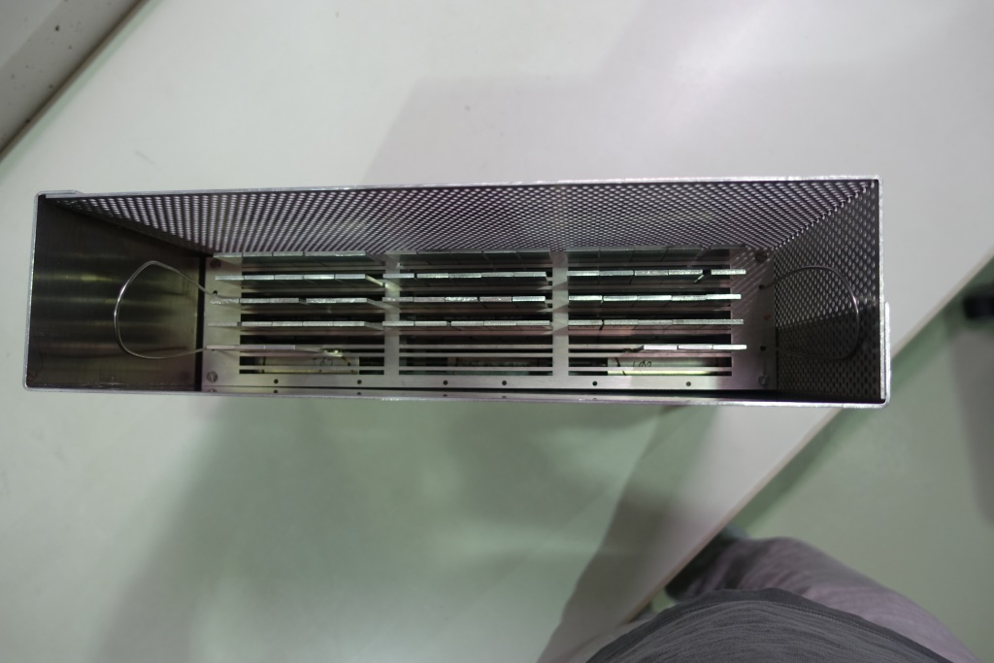
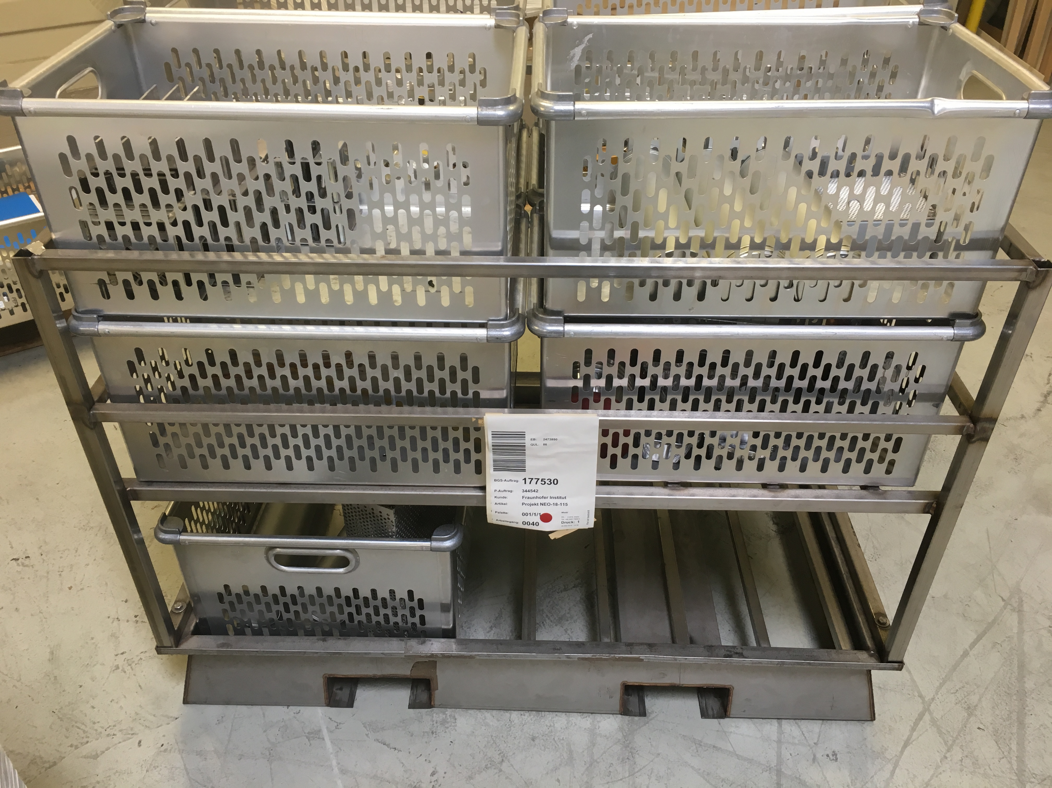
Irradiation facilities: BGS
Two irradiation options:
BGS high-dose irradiation box (30 kGy/h);
BGS Pallet-circulator (10 kGy/h);
Polling of samples from different CERN groups (EN, BE, etc.) with cost reduction
Currently suspended by EN waiting for results of CERN Call for Tender to evaluate possible other facilities (suppliers)
Fixed sample holder
Shuttle pallet
Results from call for tender expected March 2020 Until then, irradiations continue on fixed position

Slide 14
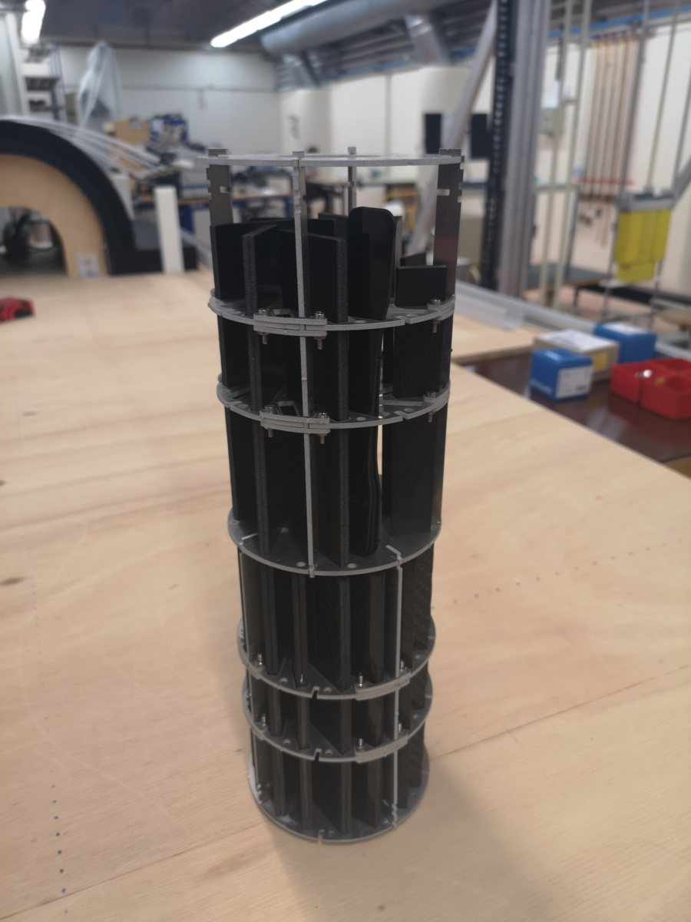
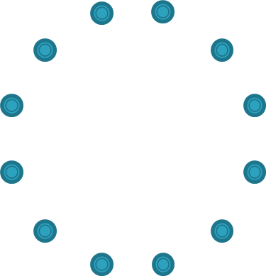
Irradiations at Sandia
Irradiation rate: > 50 kGy/h
Active cooling of the samples with forced air flow from the center
Chamber shape most suitable for irradiating standardized samples (Lap joints, double cantilever beams, dogbones, etc.)
Dim: OD ~ 110, ID ~ 40, h ~ 350 mm
Production in DT of ad-hoc sample holders to maximize sample uniformity and space usage (fill factor > 40%)
sources
samples
Cooling pipe

Slide 15
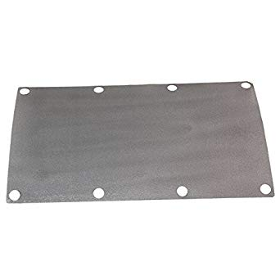
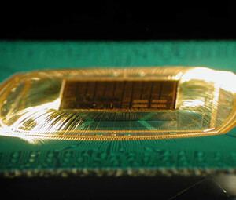
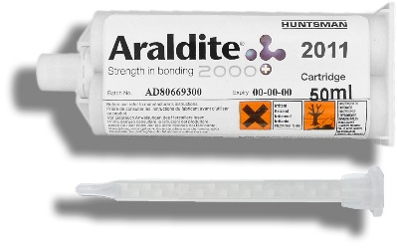
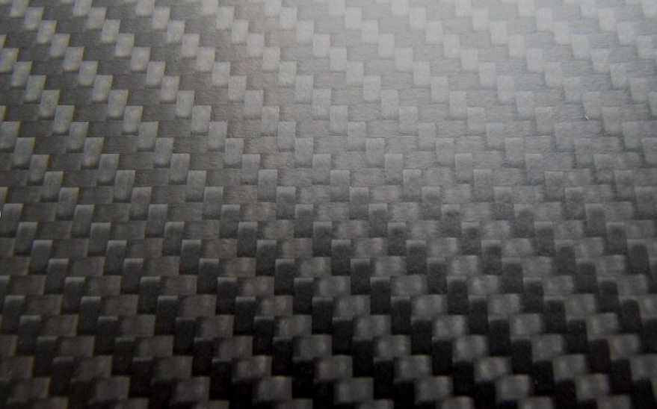
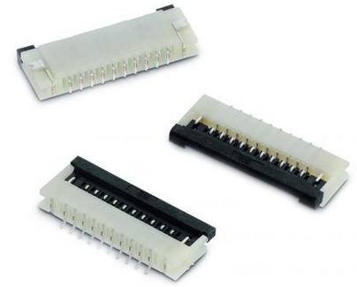
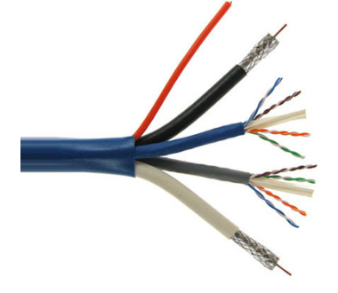
Materials of interest (categories):
Adhesives (epoxies, impregnations glues, thermally conductive glues, tapes)
Encapsulants
Thermally conductive interfaces
Connectors
Cables
CFRP or Carbon Foam structure
… and more as they come…

Slide 16
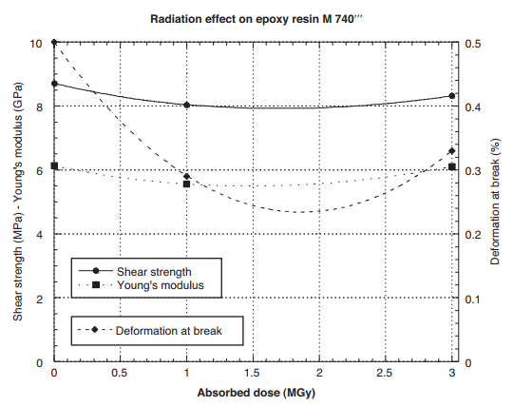
Previous data
Previous studies (CERN yellow reports et al.) are comprehensive but limited to old material generations and often low doses
For reference: most results can be found in the IMHOTEP database (http://imhotep.rl.ac.uk/)
e.g. Araldite 2011 up to 3 MGy

Slide 17
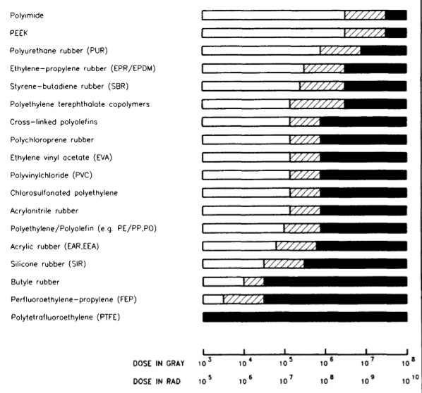
CERN Yellow reports - highlights
Halogen-free cable insulating materials

Slide 18
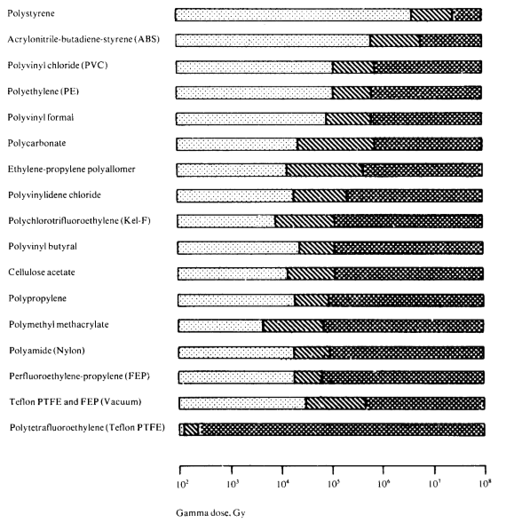
CERN Yellow reports - highlights
Thermoplastic resins

Slide 19
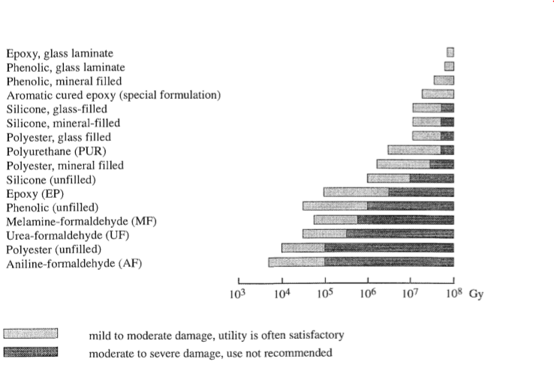
CERN Yellow reports - highlights
Thermoset resins and laminates

Slide 20
CERN Current campaign scope
Campaign organized and managed within EP-DT
Aim: find and qualify commercial or custom materials for their use in high radiation levels (HL-LHC tracker levels, 5-15 MGy)
The main focus of the campaign are structural and thermal materials. However, irradiation of other components (e.g. electrical connectors, cables) is also possible.
Irradiation is performed at gamma industrial facilities, because of:
Possibility to reach high doses on large samples in acceptable timeframes
Lack of activation of the materials, making handling and testing simpler
Polymers (adhesives, plastics, etc.) degrade mainly due to Total Ionizing Dose (displacement damage negligible)
Pooling of samples from different experiments to allow cost reduction (cost splitting between experiments based on volume occupied).
Sharing of results in a common database
So far, irradiation of samples for ATLAS, CMS, LHCb (UT, Velo)
Samples are prepared / provided by institutes with CERN guidance
Preferred samples according to different ASTM/ISO standards
Facilities available in DT to test the samples

Slide 21
Campaign timeline
So far:
2018/03 – Completed first 5 Mgy (BGS)
2018/08 – Completed first 5 Mgy on supplementary set of samples (BGS)
2018/10 – Supplemental 5 MGy (10 MGy total) (BGS)
2019/07 – Supplemental 5 Mgy (15 MGy total) (BGS)
2019/12 – 5 MGy on new samples (BGS)
2019/12 – 1 MGy, 7 MGy in Sandia
Future:
2020/01 – 5 Mgy Sandia
2020/03 – 5 MGy (BGS, fixed position)
2020/05 – 5 MGy (BGS, fixed position, pallet, other facility?)

Slide 22
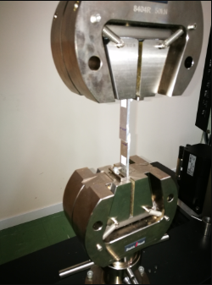
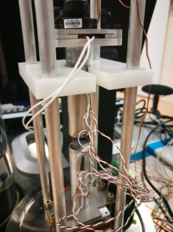
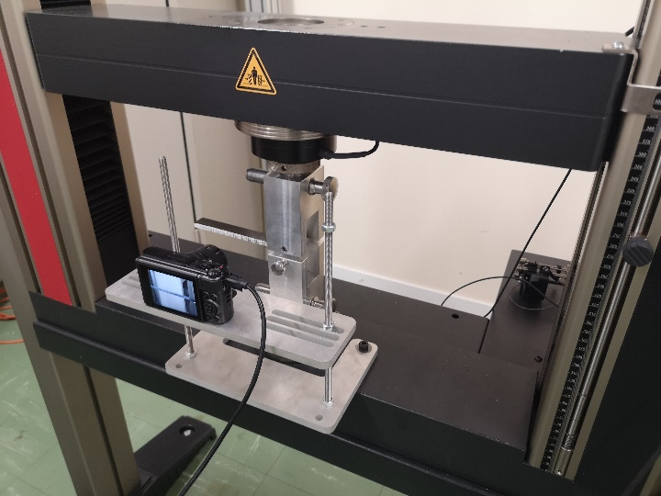
Test standards for the campaign:
Standard | Test structure | Quantity
ASTM D1002 | Single lap joints | Apparent lap shear strength
ISO 25217 | Double cantilever beams | Mode 1 fracture energy
D638 | Dogbones | Tensile properties
D5740 | Cast discs/ sandwiches | Apparent thermal conductivity
Irradiation as well of “spare” not standard samples of different materials, commercial components, etc.
Facilities available within DT for tensile and thermal testing. Otherwise, testing at institutes (especially for non-standard samples).

Slide 23
Standard sample types: Lap joints
3 mm al sheet rectangles, cut to 20 x 100 mm
Grit blasting or sandpaper of glued surface
Overlap: 12.5 mm Thickness gauging with nylon wires (typ. 200 um thickness)
Uniformity of glue fillet between samples
Tested with ASTM D1002 standard for apparent lap shear strength

Slide 24
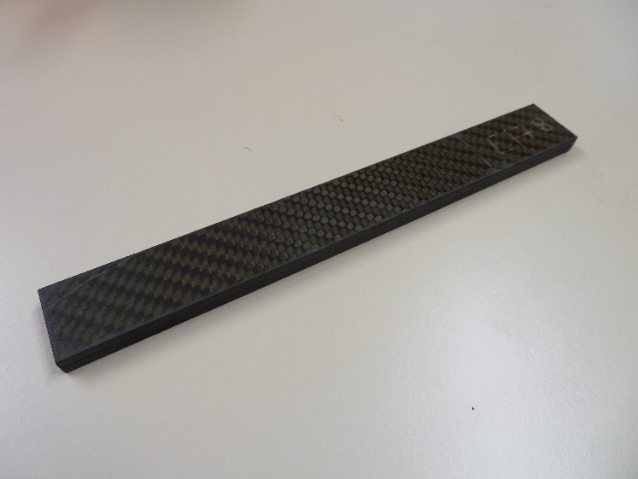
Standard sample types: Double Cantilever Beams
Introduced in last campaigns for measuring mode 1 fracture energy
Manufacturing and testing according to standard ISO 25217
CF plate, 3 mm thickness, cut to 160 x 20 mm, prepared with grit blasting or sand-paper (80 grain gauge)
Precrack (60 mm) obtained with interposition of Teflon film
Glue thickness gauge with nylon wires in precrack area and toward the end of the specimen
Thickness gauge wires
Teflon film (60 mm)
Glued length
(100 mm)

Slide 25
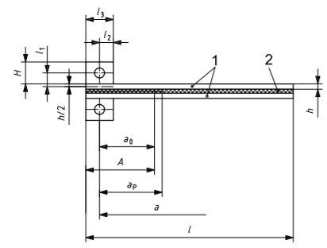
ISO 25217 standard
Measures the mode 1 fracture energy by following the time evolution of a crack as a function of applied force.

Slide 26
ISO 25217 test example

Slide 27
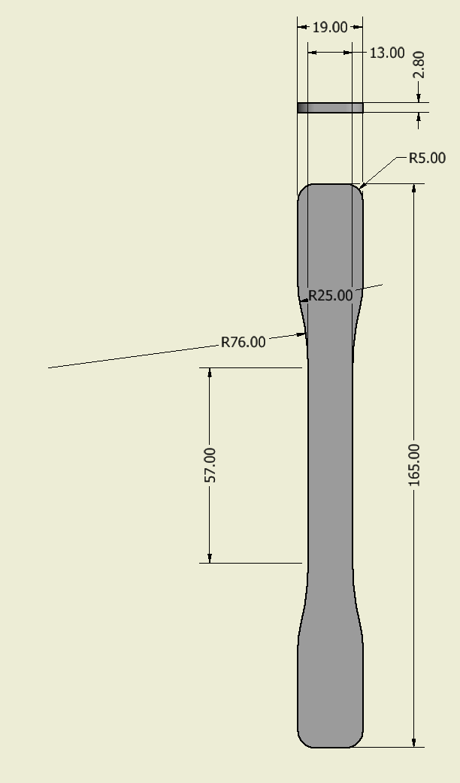
Standard sample types: Dogbones
Introduced in last campaigns for measuring tensile strength and modulus of elasticity
Manufacturing and testing according to standard ASTM D5083
Thickness ranges 2->5 mm (subset of standard)
Preparation through mould or by machining a plate of target thickness

Slide 28
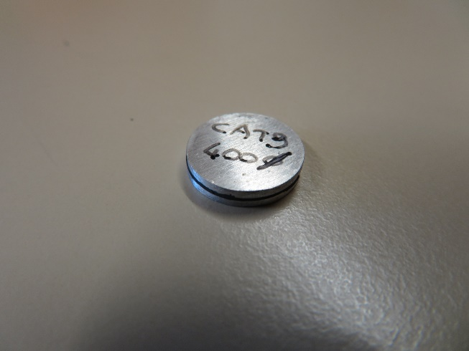
Standard sample types: Thermal samples
2 sample options:
Cylindrical sections of cast glue (diameter 12-13 mm), surface parallel to +- 10 um over all sample surface, thickness 0.5-3 mm)
“Sandwich” of 2 x 1 mm thick AL6082 sheets interposed with 0.2->0.5 mm glue, thickness controlled with non-conductive (nylon) gauge wires
Testing according to ASTM D5740 standard (apparent thermal conductivity)

Slide 29
Conductivity calculation
Force
A: meter bar sectional area (m²)
S: sample surface (m²)
t: sample thickness (m)
R_{int} :thermal resistance of interface
Heat flow (1-2)
Load cell
Heat flow (3-4)
Heating element
Hot meter bar
T4
Specimen heat flow
∆T interface to nearest probe
T3
Specimen
Cold meter bar
d_{int} = 3.8 mm
Thermal impedance
T2
d = 50 mm
Thermal resistance (gross)
Thermal resistance (net)
T1
Cooling element
Sample thermal conductivity (net)

Slide 30
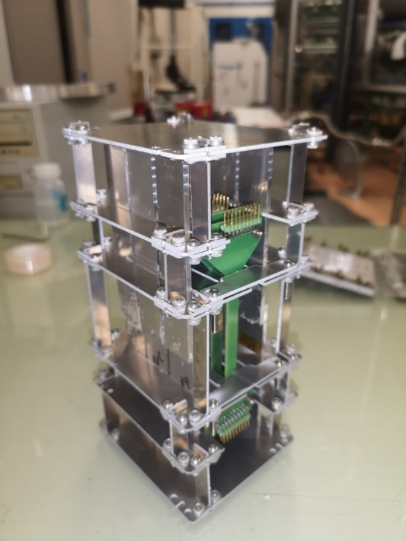
Sample holders
Custom raster holders for DCB/Lap joints/etc.
Can be cut to accommodate other sample types (e.g. PCB)
Max sample size: 100 x 70 x 170 mm

Slide 31
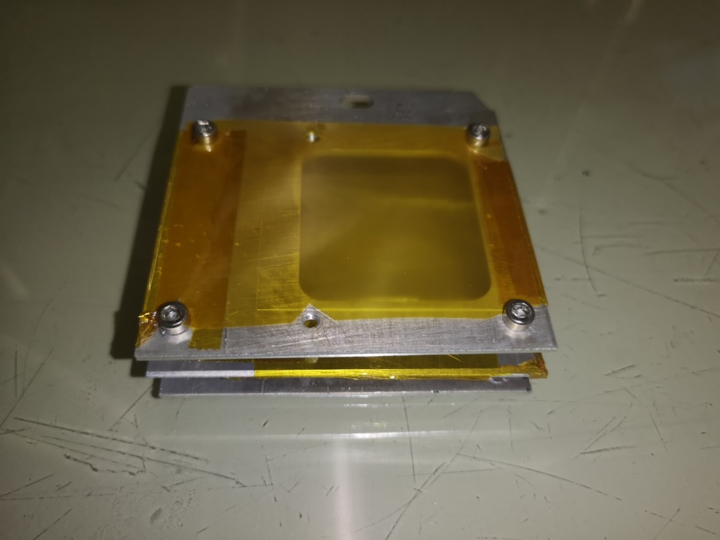
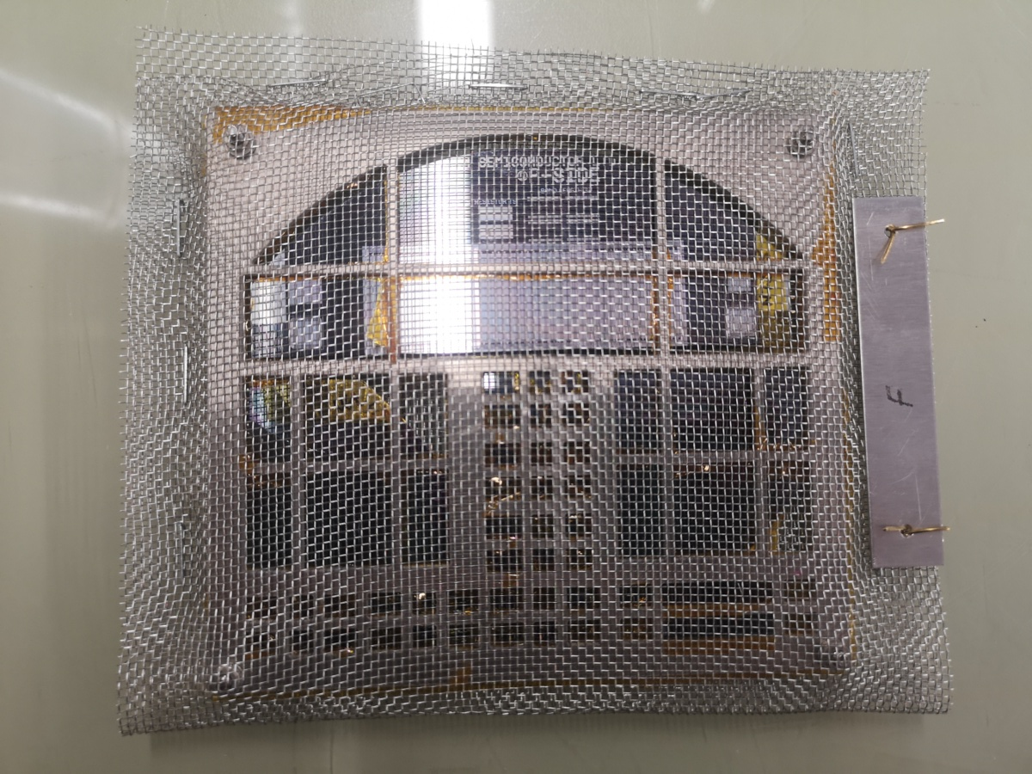
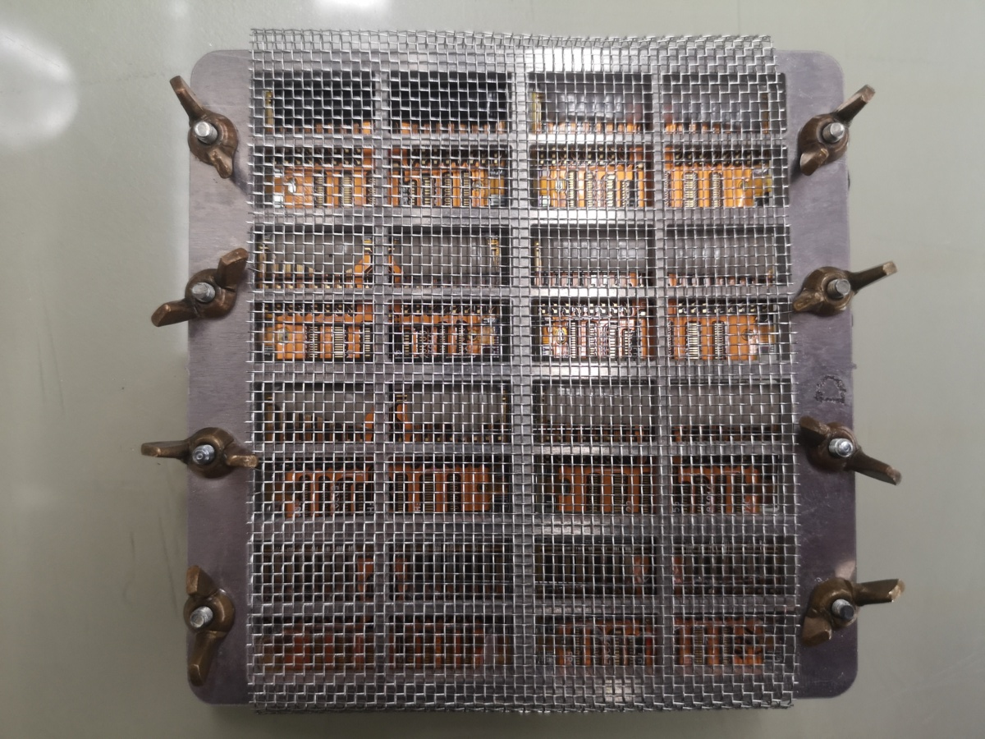
Sample holders (non standard samples)
Waterjet-cut to size
Maximum aperture to allow for air recirculation / avoid ozone accumulation

Slide 32
Current status (standardized samples only, non comprehesive list)
Standard epoxies |  | Max. planned dose | Max irradiated dose | Max tested dose | Lap joints | DCB | Thermal samples | Dogbones
Huntsman | Araldite 2011 | 15 | 15 | 7 | Yes | No | No | No
Huntsman | Araldite 2020 | 15 | 15 | 7 | Yes | No | No | No
UHU | Endfest 300 | 15 | 15 | 7 | Yes | No | No | No
Loctite | EA 9396 AERO | 15 | 15 | 7 | Yes | No | No | No
Thermally conductive epoxies
Epotek | T7109-19 | 15 | 15 | 15 | Yes | No | No | No
Polytec PT | TC 418 | 15 | 15 | 15 | Yes | No | No | No
AIT | EG7655 | 15 | 15 | 7 | Yes | No | No | No
AIT | EG7655 LV | 15 | 15 | 7 | Yes | No | No | No
AIT | EG7658 | 15 | 15 | 7 | Yes | No | No | No
Loctite | Stycast 2850 FT | 15 | 5 |  | Yes | Yes | Yes | No
Epotecny | E707RT | 15 | 0 | 0 | No | Yes | Yes | Yes
Masterbond | EP30TC | 15 | 0 | 0 | No | Yes | Yes | Yes
UV Curing epoxies
Dymax | 9-20801 | 15 | 15 | 7 | Yes | No | No | No
Double sided adhesive tapes
Nitto Denko | No. 5600 | 5 | 5 | 5 | Yes | No | No | No
Tesa | Tesafix 4962 | 15 | 15 | 7 | Yes | No | No | No
3M | VHB 5909 | 15 | 15 | 7 | Yes | No | No | No
Double sided adhesive tapes
Nitto Denko | No. 5600 | 5 | 5 | 5 | Yes | No | No | No
CFSMC compounds
Astar | EK03-5750 | 15 | 0 | 0 | No | No | No | Yes
Astar | PGK5250-R63 | 15 | 0 | 0 | No | No | No | Yes
Plastics
Sabic | ULTEM 1000 | 15 | 0 | 0 | No | No | No | Yes

Slide 33
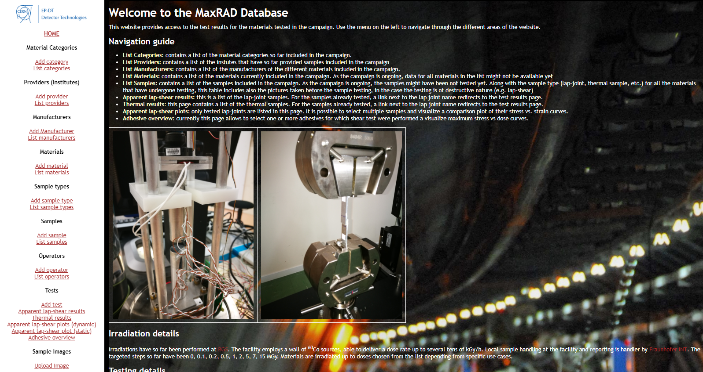
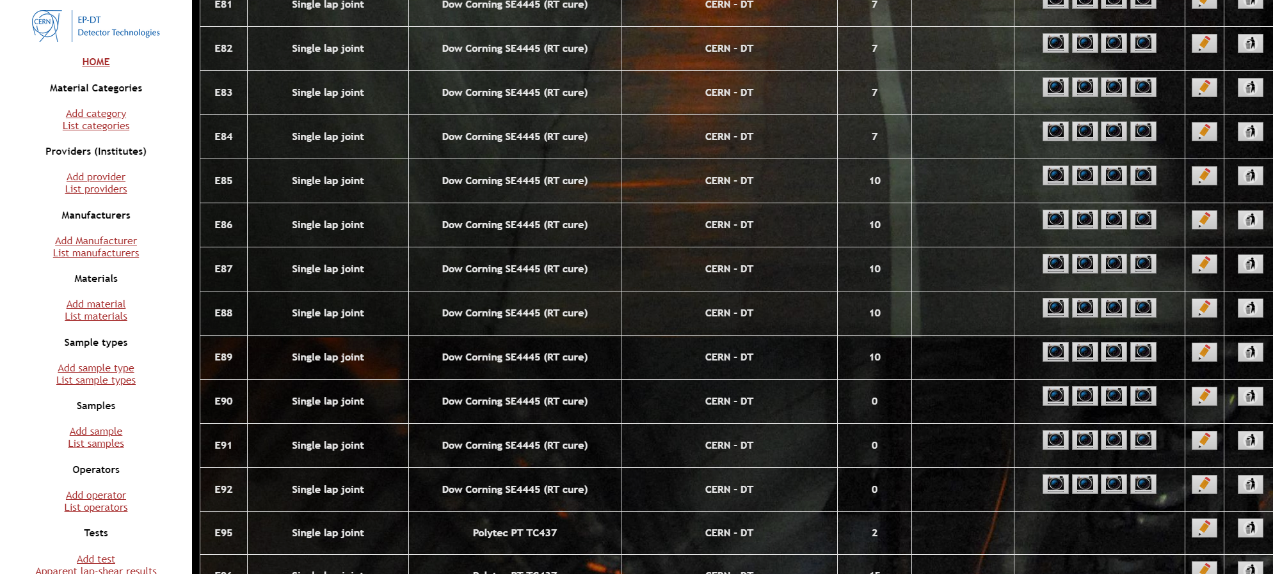
MaxRAD: Results reporting/sharing
A dynamic website was developed to store and visualize the results of the irradiation campaign
The website is intended to be publicly accessible (but registration to an e-group is required, for tracking purposes)
Can be accessed at https://maxrad.web.cern.ch
At present: online visualization of lap-shear results.
To be added: online visualization for tensile tests, Double Cantilever beams, reporting

Slide 34
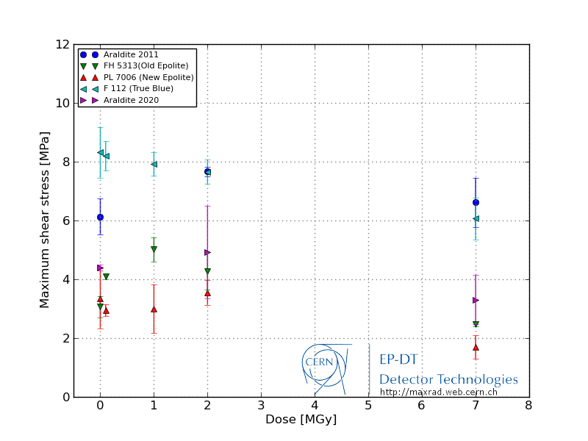
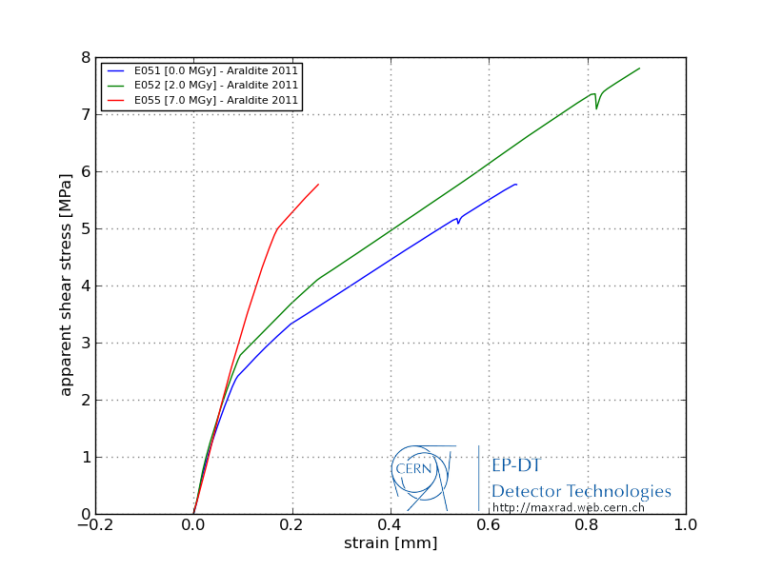
Some results: non-filled epoxies
Mainly radiation hard (some adhesives show slightly worse degradation)
Tendency to shift elastic-plastic transition to higher stresses

Slide 35
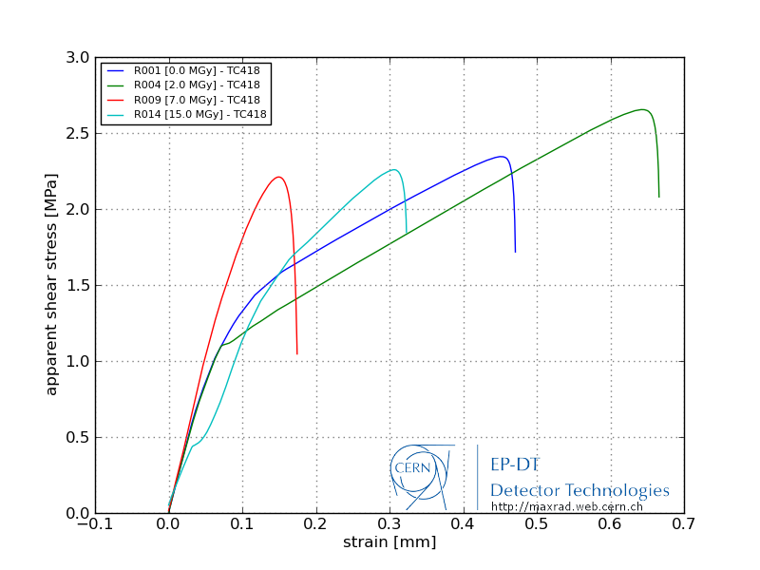
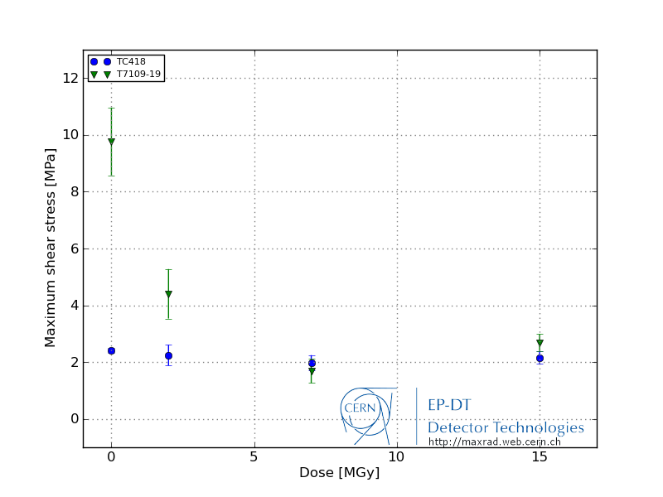
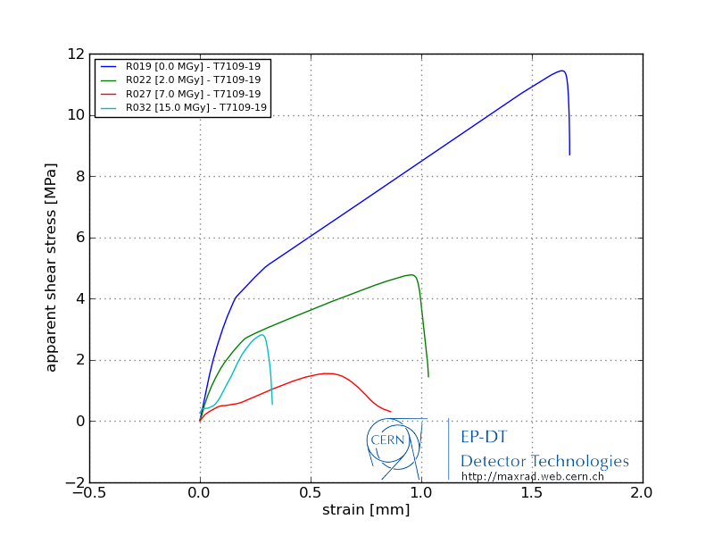
Some results: thermally conductive epoxies
Two adhesives studied so far (more being irradiated)
Either significant degradation in maximum shear stress from higher values or no major changes when starting from low values

Slide 36
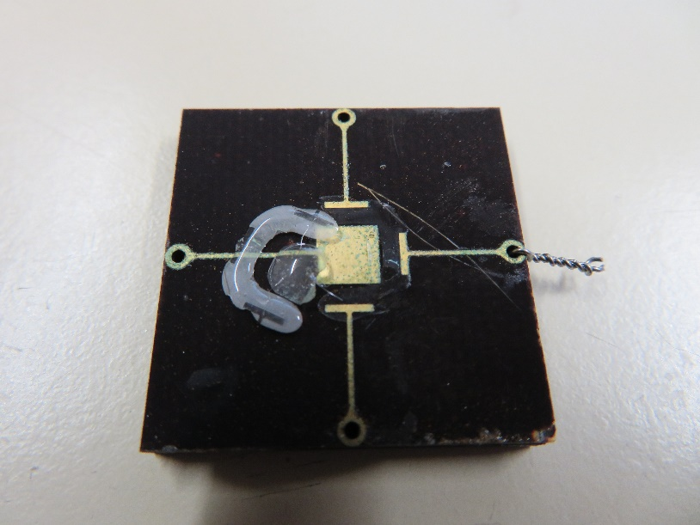
Encapsulants
Two classes of commercial wirebond encapsulants
Silicone-based (E.g. Sylgard 186)
Vitrification and embrittlement of the compound which detaches in pieces or clean from the board
(Poly)urethane based (E.g. Dymax 9001)
Hardening and breakage of wire bonds at thermal cycling
As of today we still don’t have a viable candidate for doses > 2 Mgy (research pursuing “soft” epoxies)

Slide 37
Conclusions and outlook
The campaign is ongoing and will likely continue until all Phase II upgrades enter production – possibly further.
Lap shear results available for many adhesives up to 7-15 MGy. Testing of already irradiated samples is ongoing.
We are going to start systematic characterization of DCB/dogbone samples for a selected subset of glues.
The communities should pre-qualify adhesives and materials for their unirradiated properties (e.g. viscosity, curing time, CT). Afterwards they can be radiation quawlifiedto assess any performance degradation.
Relevant tests for the chosen material should always be defined before irradiation, thinking as well about the interaction of the material with the surrounding environment.
Problematic areas identified in the field of thermally conductive adhesives (limited choice with HL-LHC trackers requirement e.g. too viscous, boron fillers etc.)
There is still no viable choice for encapsulants. Standard commercial solutions fail at low radiation doses.
Thanks for the attention!

