Slide 1
SEE Testing of VLSI electronics
F.R. Palomo¹, E.López-Morillo¹,F. Márquez¹, F.Muñoz¹
fpalomo@us.es
¹Departamento Ingeniería Electrónica, Escuela Superior de Ingenieros
Universidad de Sevilla, Spain

Slide 2

In a Nutshell
Generalities about SEE effects
SETs, SEUs and SEFIs
Sensitivity Mapping
SEE Sensitivity Simulation Analysis
SEE Testing
RD53SEU Chip

Slide 3
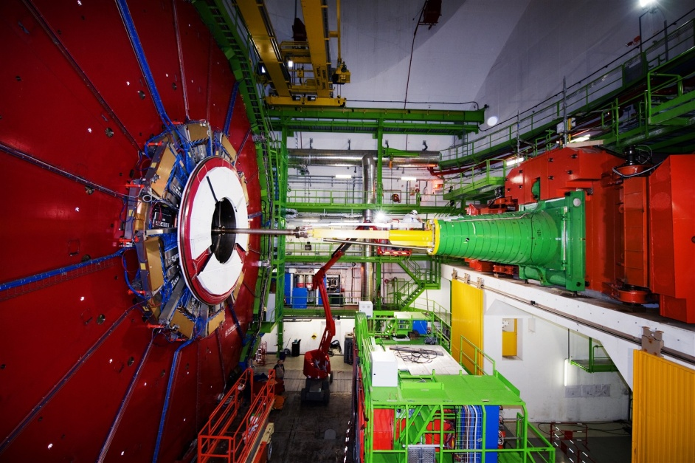
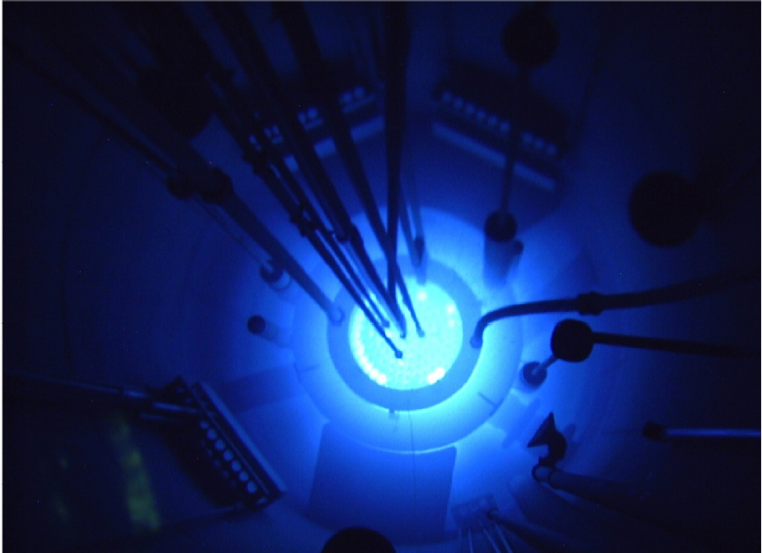
Compact Muon Solenoid CMS, LHC, CERN
Detector microelectronics
Hadrons, Leptons, γ and X photons
Triga Reactor Mk III,
Oregon State University
Control Microelectronics
γ photons and neutrons

Slide 4
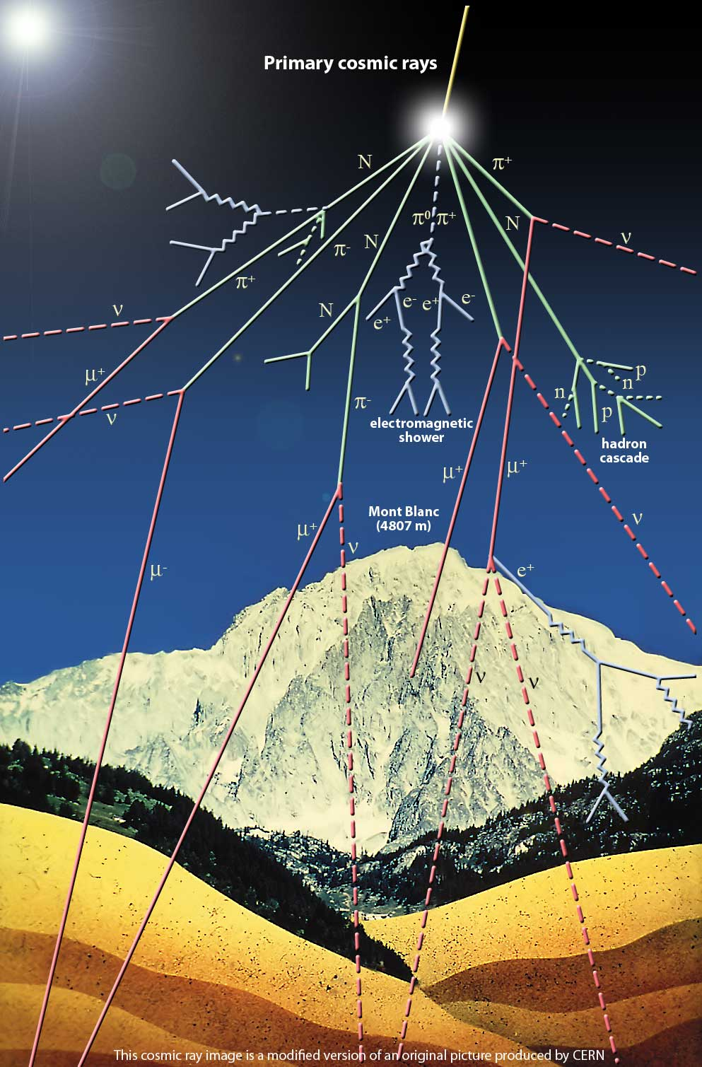
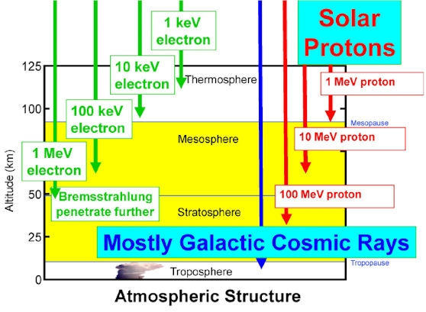
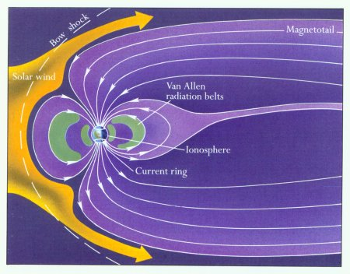
Planetary Ionospheres, Cosmic rays
(protons, electrons, ions)
Stratosphere: cosmogenic spallation
(neutrons, 4#/cm²-s at 15 km)
Satellites
Aviónics

Slide 5
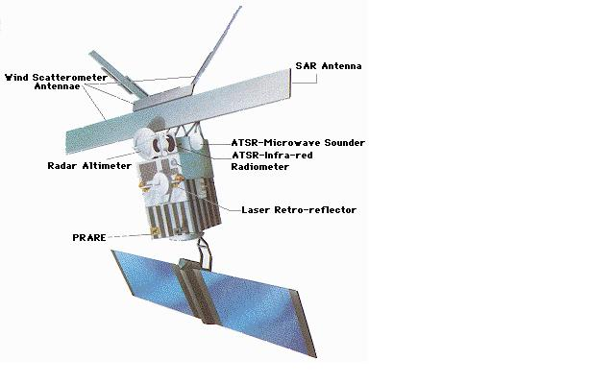
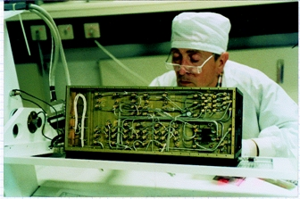
1991 : ERS-1/PRARE Satellite
July 1991 : Earth Resource Satellite ERS-1 launched into an 784 km sun-synchronous polar orbit.
During the 5 days of operation a number of anomalies were noted inc. soft errors and a processor ‘reboot’.
After 5 days of operation the PRARE instrument shut down immediately following a transient over-current conditions and could not be restarted.
Ground testing identified the possible cause of failure to be semiconductor related (EEPROM, SRAM).
Proton irradiation of the engineering model confirmed the failure to be a latch-up in a 64K-bit SDRAM
PRARE: X band Transceiver
Earth Resource Satellite ERS-1
From R. Harboe Sorensen RADWG day 2005

Slide 6
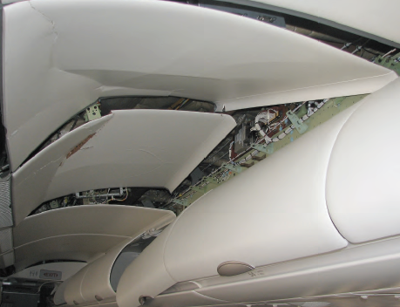
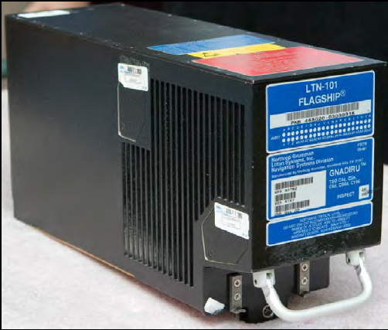
2008 : Qantas Flight 72 A330/ADIRU
October 7th 2008: The Airbus A330 VH-QPA, Qantas Flight 72 en route Singapur-Perth, FL370 (11277m) got two consecutive altitude sudden drops (-0.8 g).
Injured people on board, MAYDAY and emergency landing at Learmonth, West Australia.
Investigation demonstrated wrong data peaks in the nº 1 ADIRU (Air Data Reference Unit) that forced to absurd autopilot manoeuvres.
2008 Autumn, 45º latitude, solar minimum and cosmic rays maximum. Neutron flux ~1000 neutrons/cm2-hora on October 7th 2008, FL400 (12192 m).
Possible cause: neutron induced SEUs in the nº 1 ADIRU CPU RAM.
Cabin ceiling damage due to
flight attendant impact during the sudden drops.
ADIRU nº 1 model LTN-101 from Northrop Grumman
ATSB Transport Safety Report AO-2008-070

Slide 7
Dosimetry in Iberia Airline
Starting in 2000, Iberia Airlines and CIEMAT developed a measurement program for dosimetry in Iberia intercontinental flights, first with non permanent dosimeters:
Low LET (ionising) :RSS131 Ion chamber, Gamma tracer GM tube, FH40G proportional counter, Dosicard pocket dosimeter,
High LET (neutrons): SWENDI2 ³He+W counter, SNM-50X 3He+Pb,
Tissue equivalent proportional counter: Hawk TEPC.
All of them calibrated at CERF facility (CERN)
Nowadays the long route Iberia fleet (A340, A330) has permanent LIULIN dosimeters on board, maximum anual effective dose 3.5 mSv.
Validación experimental de las dosis calculadas para las tripulaciones aéreas de IBERIA mediante espectrómetros de Si instalados de modo
permanente en los aviones, J.C.Sáez Vergara et al. XVII Congreso nacional de SEFM, Alicante, 2-5 Junio 2009

Slide 8
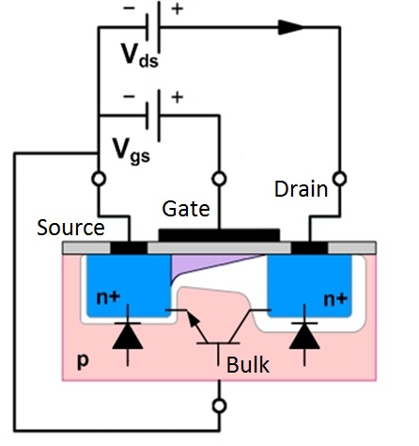
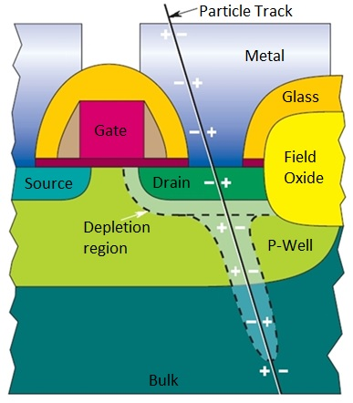
Generalities about SEE Description (1/3)
Radiation effects in Electronics
Vulnerably to
Total Ionization Dose (TID)
Vulnerably to Transient Ionization
(Single Event Currents)
Vulnerably to Displacement Dose Damage

Slide 9
Any modern digital MOS tech is SEE sensitive!
As a general rule: increasing miniaturization means
increasing SEE sensitivity and decreasing TID sensitivity
SEE Cross section
TSMC 65 nm
Geostationary Orbit
Proton flux
65nm technology development for electronics in the
LHC at CERN, F.Anghinolfi, AMICSA 2016
Low energy proton single event upsets in SRAM, B.Sierawsky, 2012
Below 65 nm, SEE effects will be common in any proton/ion radiation field

Slide 10
Single Event Effect (JPL-NASA): radiation-induced errors in microelectronic circuits caused when charged particles lose energy by ionizing the medium through which they pass, leaving behind a wake of electron-hole pairs..

Slide 11
SEE effects are System Effects
Characterization of a comercial 65nm CMOS technology for SLHC applications, S.Bonacini et al. 2012 JINST 7 PO1015

Slide 12
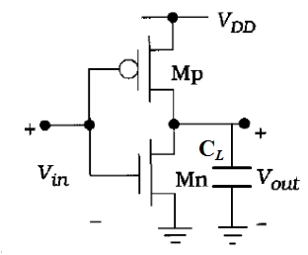
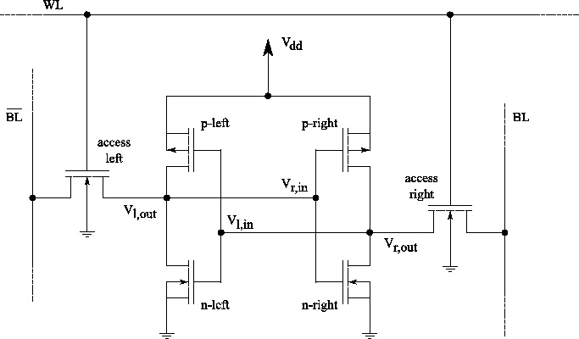
CMOS inverter response to SEE
A simple CMOS inverter gate shows switching behavior: its able to charge and discharge the capacitive load when V_{out}=V_{in} . The CMOS inverter is a basic block for digital elements.
INVERTER
NAND2
NOR2
6T SRAM
Robustness of CMOS circuits designed for space and terrestrial environment, J.M:Dutertre, F.M.Roche XVI Conference on Design of Circuits and Integrated Systems, Nov 2001, Porto Portugal .

Slide 13
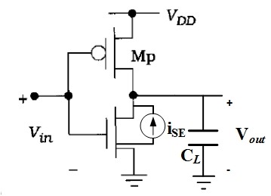
Critical Charge
τ_{i}: inverter intrinsic time constant
C_{O} is the total output capacitance
V_{dd} is the power rail voltage
τ_{e}: charge collection single event time constant (< 1ps)
τ_{e}<<τ_{i} implies Single Event Effect (switching)
So at Critical node (Vout) the SEE induced ΔV is:
i_{SE}(t) is the single event photocurrent
Q_{collected} is the total charge delivered to/from
the node by the single event photocurrent
C_{N} is the total nodal capacitance
Q_{crit} is the total charge delivered to/from
the node by the single event photocurrent
C_{N} is the total nodal capacitance
ΔV_{nm} is the node voltage
Extreme Environment Electronics, J.D.Cressler, H.A.Mantooth (eds), CRC Press 2013, chap. 15

Slide 14
Critical Charge
Extreme Environment Electronics, J.D.Cressler, H.A.Mantooth (eds), CRC Press 2013, chap. 15

Slide 15
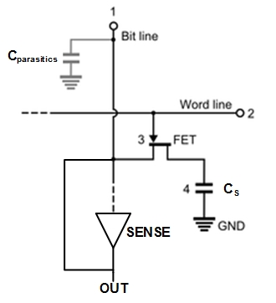
DRAM
Read: Word line=1, nmos ON, C_{s} connected to sense. Because there are
always leakages (C_{parasitics}), the SENSE amplifier feedbacks to bit
line to regenerate C_{s} with the original value.
Write: 1 or 0 forced from Bit line with Word line=1, C_{s} charges/discharges
according to Bit line value.
Strictly speaking, DRAMs have no SEE bitflip (SEU) because there is no flip-flop switching. All we need is a degradation in the C_{s} charge value; if it exceeds the noise margin of readout circuit we got a logic error.
DRAM typical SEE error is ionization charge collection in the binary cell: particle hit happens in or near Cs or at FET source. The key FET opens so a transition 1->0 goes to the output.
Less frequent is a SEE error in bit line. For this to happen, the bit line has to be floating (i.e., during a read phase with key transistor in conduction state). Collected charge going to C_{s} can be enough to output a bit change.
Q_{crit} = C_{s} ΔV_{s}
Extreme Environment Electronics, J.D.Cressler, H.A.Mantooth (eds), CRC Press 2013, chap. 15

Slide 16
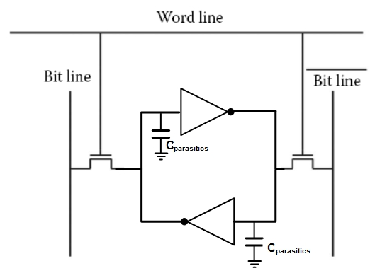
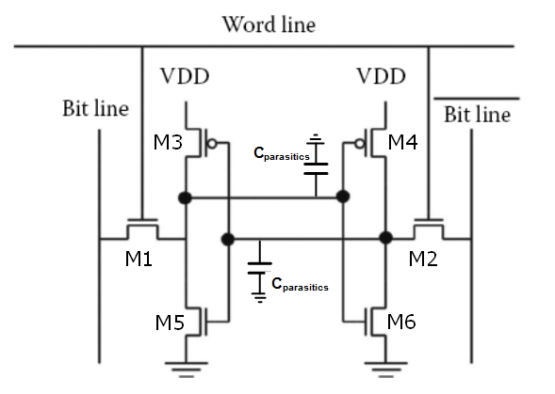
SRAM
A 6T SRAM has 2 key transistors for bit lines and a pair of CMOS inverters feedback coupled.
Read: M1, M2 on, Word line=1 tensión (Q,/Q)->(BL,/BL)
Write: M1, M2 on, Word line=1, (BL,/BL) force values by current injection to (Q,/Q) to switch (flip-flop) the feedback coupled inverters.
The load capacitor for (M3,M5) first inverter is the input capacitor of (M4,M6) second inverter, so
C_{load}= C_{gateM4} + C_{gateM6}+C_{parasitics} and the critical charge equation is:
Stable states: Q=0 , /Q=1
Q=1 , /Q=0
inv1
Q_{crit} = C_{load,inv1} ΔV
inv2
inv1
inv2
If gate of inverter 2 (M4,M6) is over the switching threshold, the inv2 output feedback forces a switch in
inv1 (M3,M5) gate. The flip-flop state changes without
forcing from bit lines (= bitflip).
Bitflip will happen with key transistors (M1,M2) on or off and bit lines floating (read phase). During the write
phase, bit lines are forcing values so the bitflip is impossible and we will only see a particle induced glitch (Single Event Transient)
Extreme Environment Electronics, J.D.Cressler, H.A.Mantooth (eds), CRC Press 2013, chap. 15

Slide 17

Radiation Definitions and Units
Cross sections are a useful metric for memory cells (cross section related to target area), not so useful for SETs (target area is known in advance, corresponding to a transistor area) and not useful at all for SEFIs (impact area and observed anomalous outputs have only a correlation, not a hard causal relation)
Device Cross-Section:
Single Event sensitive Area,
dependent on the ionization track energy transfer.
Radiation tolerant electronics for high energy physics experiments, D.Falchieri, INFN 31st March 2017

Slide 18
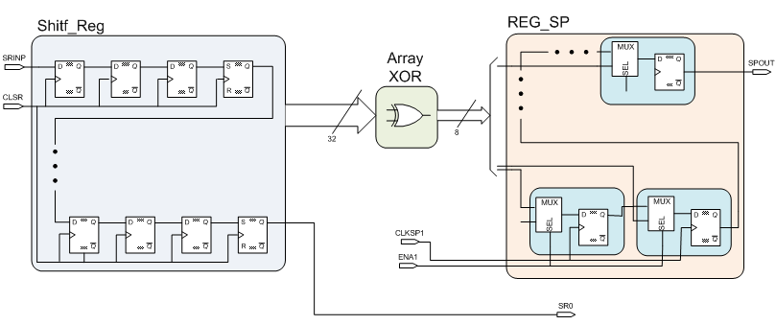
SEU (bitflips) and SET (glitches)
General Rule:
SETs happens everywhere
SEU happens only when ion hits
a memory cell
Single Event Upsets (Red) affect to memory cells producing bit flips (there is a LET threshold)
Single Event Transients (Blue) affect to any transistor, producing glitches (no LET threshold)
SETs effects are harder to detect and can produce Cascade Bitflips

Slide 19
Single Event Functional Interrupt
JESD89A, 10/06: A soft error that causes the component to reset, lock-up, or otherwise malfunction in a detectable way, but does not require power cycling of the device (off and back on) to restore operability, unlike single-event latch-up (SEL), or result in permanent damage as in single event burnout (SEB).
SEFI sources: configuration registers, reset generators, clock spine, I/O blocks (LVDS in particular)
They appear in mixed signal integrated designs (digital&analog electronics in the same chip)
SEFI are hard to detect because:
They have distributed effects: a SET glitch in the reset generators will affect the whole digital block
They could be masked: particle impact zone is not the main affected functional area, example: a hit
  in an I/O block (Low Voltage Differential Signalling tipically) will introduce corrupted data without
  notice (because there is no “Golden data” to compare).
They are non local: target area is not the main affected functional area, for example,
a SET in one buffer of the clock distribution spine will introduced jitter in remote parts of the
digital circuitry but not in others.
4. They are asynchronous: a SEU in a configuration register can affect the behaviour of a
Finite State Machine long after the hit, depending on the FSM state.
Core
PLL (Clock
Generator)
SEFI assurance needs Sensitivity Maps

Slide 20
Sensitivity Mapping
Sensitivity Mapping: we got information about Integrated Circuitry sensitivity to SEE in spatial coordinates (target coordinates)
and in time (particle hit time-stamp).
By Simulation: we can simulate the hits at the schematic level using a pulsed current source; this gives us information about
SEE sensitivity and also about which anomalous signals to expect in the output/probe ports.
By Experiment: with an ion microprobe end station and the appropriate readout electronics we can establish a correlation
Between the hit area/time of impact and the singular event observed at the output/probe ports. A pulsed laser can also be used
but only if metalization is not an issue (short list of available targets or shining laser through the circuit backside after optical
polishing)
Diagnose of radiation induced single event effects in a PLL using a heavy ion microbeam, S.Sondon et al., 2013 14th Latin American Test Workshop,
DOI 10.1109/LATW.2013.6562682

Slide 21
BroadBeam or MicroBeam: Both
Ion Broadbeam | Ion Microbeam
First Technique to Apply | Apply just in case Ion Broadbeam is not enough
No hit coordinates | Hit coordinates available
No detailed time-stamp | Detailed time-stamp at low fluxes
Well stablished technique for SEE assesment | Relatively new technique
Recommended for simple designs (memories, shift registers) | Recommended for complex designs (mixed signal designs)
Able to make cross sections characterizations | Cross sections AND Sensitivity maps
Difficult to confront with simulation sensitivity maps | Specifically to complement simulation with physical sensitivity maps

Slide 22
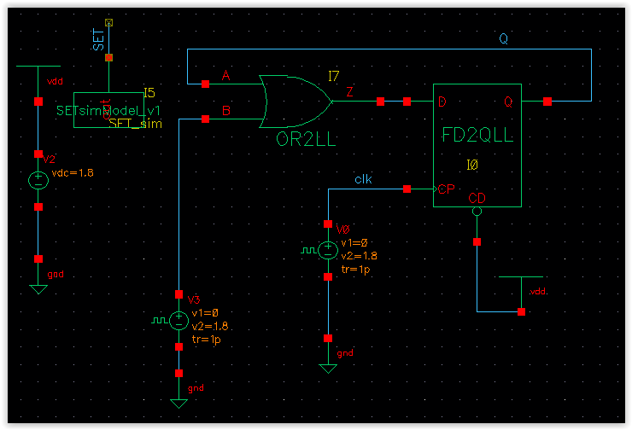
Sensitivity Maps by Simulation
What is AFTU?
The Analog FTU Hardware Debugging System
is a software tool to evaluate the SEE sensitivity
of analog/mixed signal circuits
at transistor level
AFTU parses a Spectre design netlist to generate a parametric simulation Ocean script
-Analysis of Transient Effects in Analogue Topologies, F.Marquez, F.Muñoz, F.R.Palomo, M.A.Aguirre and M.Ullán, AMICSA 2012, Noordvijk, Netherlands 26th -28th August 2012, http://microelectronics.esa.int/amicsa/2012/amicsa2012.htm
-Automatic inspection of SET sensitivity in analog cells, F.Márquez, F.Muñoz, M.A.Aguirre, F.R.Palomo and M.Ullán, SMACD’12, Sevilla, Spain, 19th-21st Sept. 2012 http://www2.imse-cnm.csic.es/~smacd2012/SMACD_2012/HOME.html
-AFTU, an analog single event effects automatic analysis tool, F.Marquez, L.Sanz, F.R.Palomo, F. Muñoz and M.A.Aguirre, AMICSA 2014, CERN, Switzerland, 30th June-1st July 2014, https://indico.cern.ch/event/277669/
-Automatic Single Event Effects Sensitivity Analysis of a 13-Bit Successive Approximation ADC, F.Márquez, F.Muñoz, F.R.Palomo, L.Sanz, E.López-Morillo, M.Aguirre and A.Jiménez, IEEE Transactions on Nuclear Science,62(4) 2015, pp.1609-1616

Slide 23
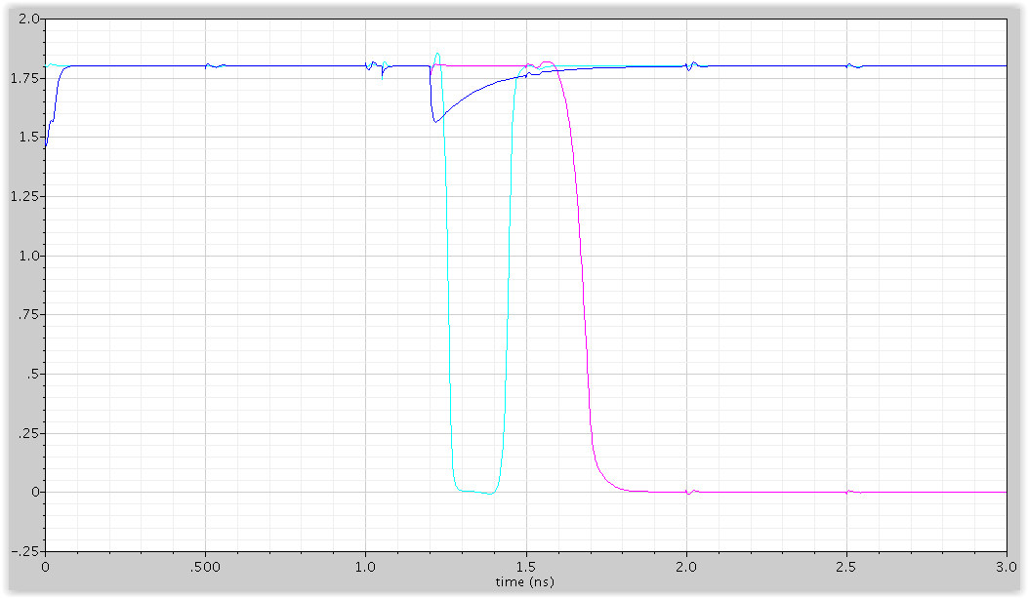
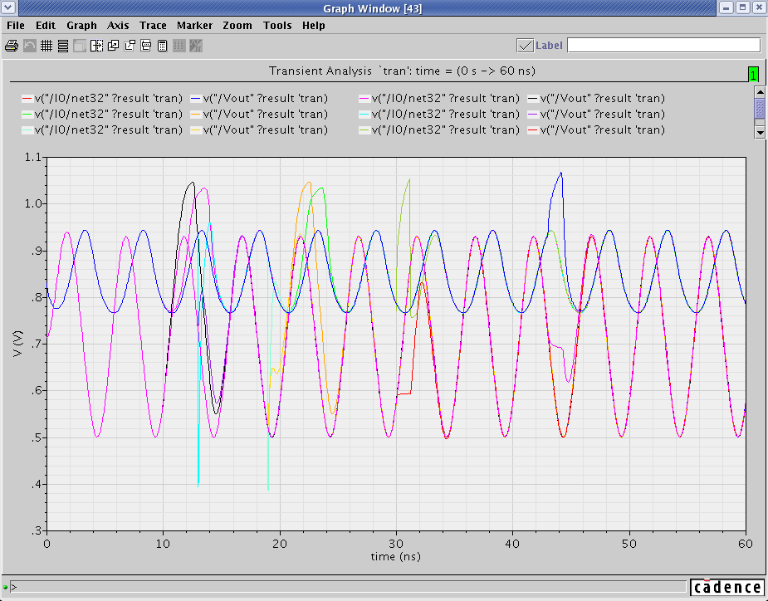
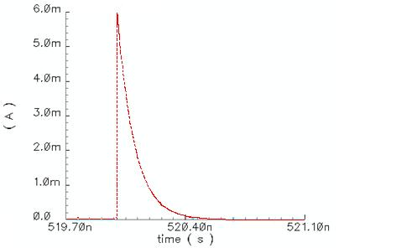
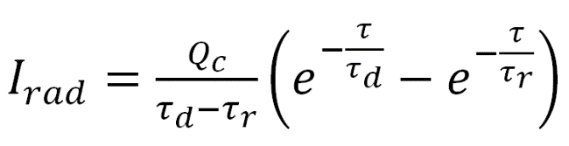
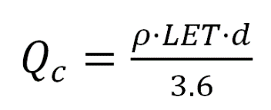
…emulates Single Event Effects…
Injection Current
Default Model
An injection current source at every node or at user selected nodes is the way to emulate the SEE. The injection source model can be changed.

Slide 24
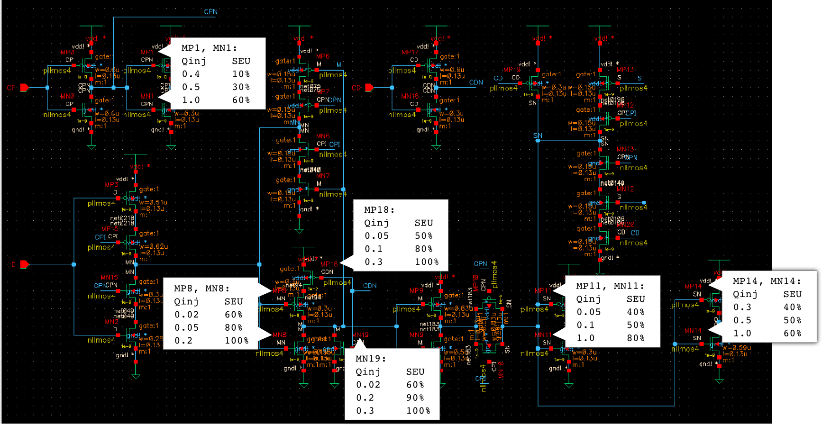
... and evaluates vulnerabilities
The user defines injection and evaluation zones
and select the appropriate hard coded heuristic to analyze the parametric simulation results
D-latch circuit , STMicroelectronics 130 nm
The final result is a list of vulnerabilities (in terms of the heuristic) for each user selected node in the design.

Slide 25
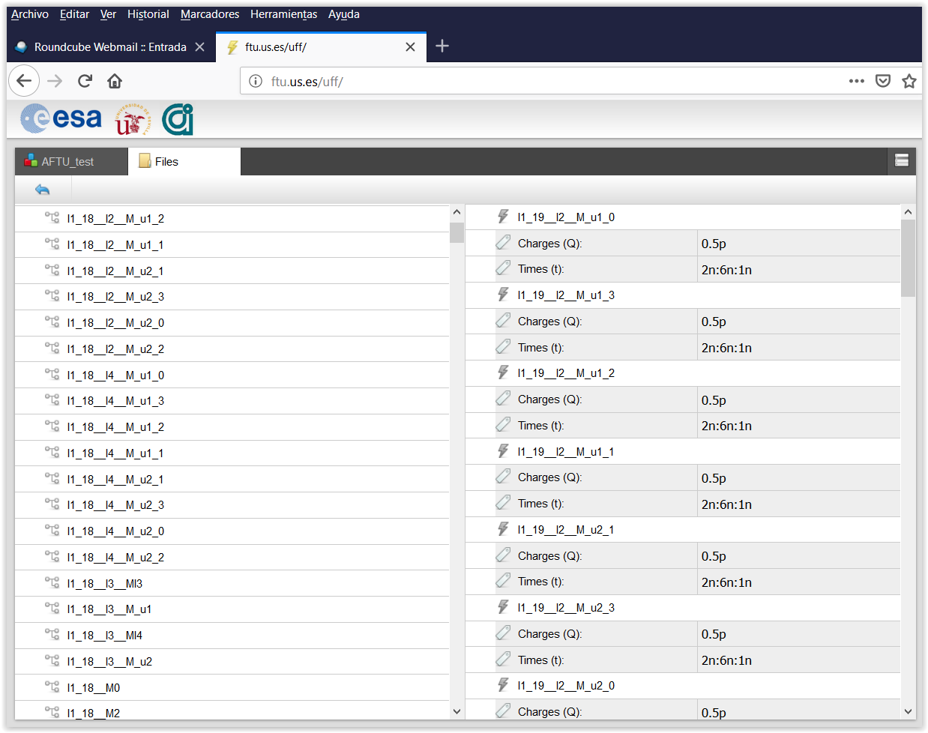
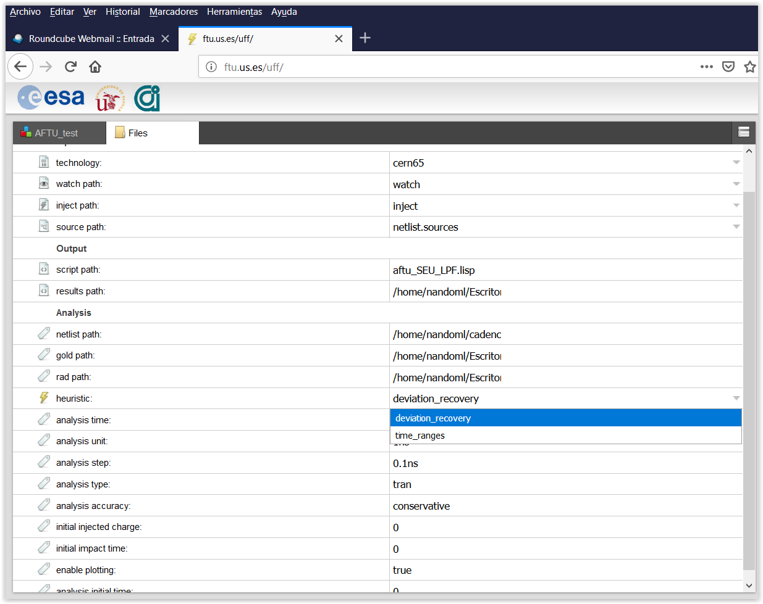
User Web Interface (Fault Injection Campaign)
User Web Interface (Heuristics)

Slide 26
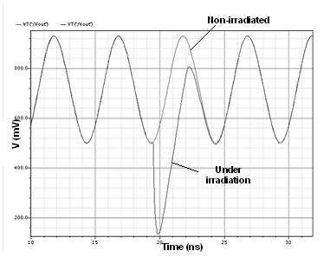
Hard Coded Heuristics
Deviation Recovery
(ex. analog circuits SET’s)
Time Ranges
(ex. digital SEU’s & differential circuits SET’s)
Recovery Time
Signal Voltage Deviation
Total time between
up to 4 signal thresholds

Slide 27
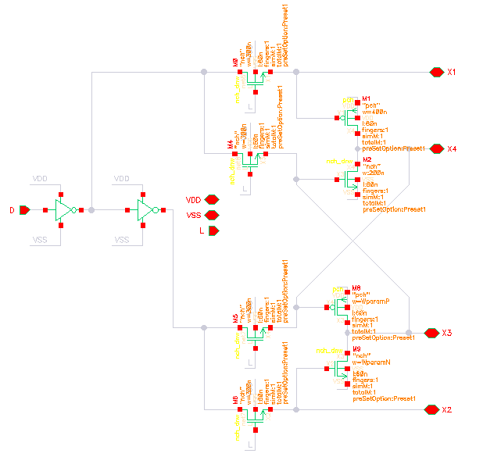
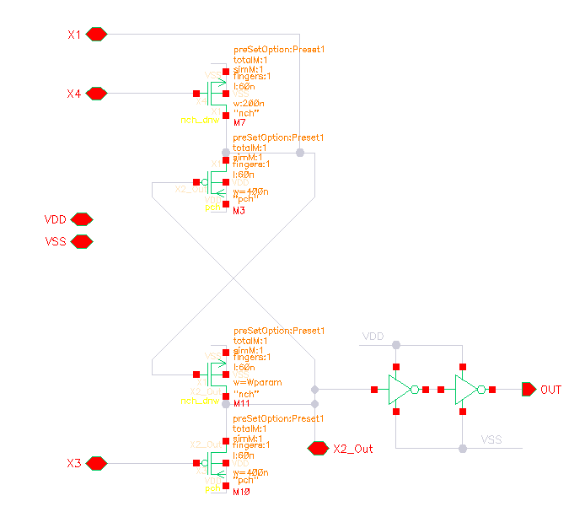
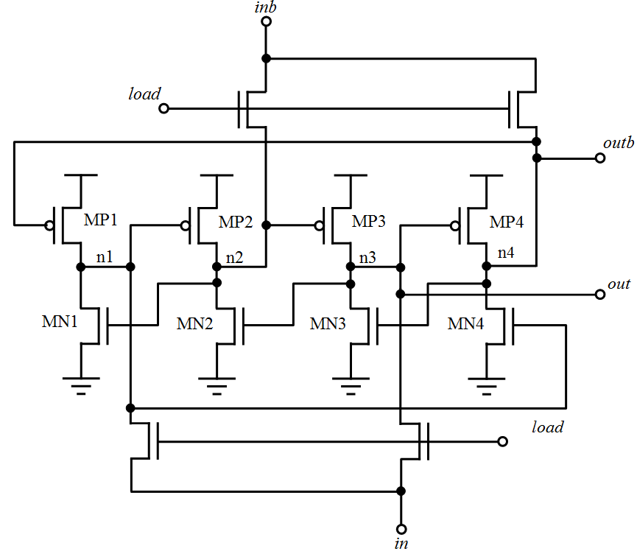
Analysis of FE-I4 DICE structures
Circuit schematics (interleaved version)
  Increased robustness against SET/SEU due to DICE structure
  Only affected by simultaneous impacts at n1,n3 or n2, n4
LOAD line

Slide 28
DICE structure analysis with AFTU
Impacts at 4 different times (0.5, 1.25, 2.5, 3.25 ns) in every transistor of the DICE
  Every possible input/output state is analyzed
According to results, there are 4 classes of transistors:
  Class I: no effect on the latch output
  Class II: transient glitch at the latch output, with no permanent effect (SET)
  Class III: a change of the state at the output (SEU)
  Class IV: a pair of transistors simultaneously impacted that generate a SEU
  at the latch output.

Slide 29
DICE structure analysis with AFTU
Qinj | Class | Transistors
0.05 pC | I | All except class II
 | II | M10, M11, M9, M3
 | III | None
 | IV | (M11-M8), (M11-M2), (M10-M7), (M10-M1)
0.1 pC | I | All except class II
 | II | M10, M11, M9, M3
 | III | None
 | IV | (M11-M8), (M11-M2), (M10-M7), (M10-M1), (M11-M6), (M11-M5), (M10-M0), (M10-M4), (M7-M9), (M7-M0), (M7-M4), (M9-M1), (M9-M0), (M9-M4), (M3-M2), (M3-M5), (M3-M6), (M8-M3), (M8-M6)
0.2 pC | I | M7, M8, M2, M1, MU1_X_M_u3
 | II | M10, M11, M9, M3
 | III | M0, M4, M6, M5, MU1_X_M_u2
 | IV | (M11-M8), (M11-M2), (M10-M7), (M10-M1), (M11-M6), (M11-M5), (M10-M0), (M10-M4), (M7-M9), (M7-M0), (M7-M4), (M9-M1), (M9M0), (M9-M4), (M3-M2), (M3-M5), (M3-M6), (M8-M3), (M8-M6)
0.3 pC | I | M7, M8, M2, M1, MU1_X_M_u3
 | II | M10, M11, M9, M3
 | III | M0, M4, M6, M5, MU1_X_M_u2
 | IV | (M11-M8), (M11-M2), (M10-M7), (M10-M1), (M11-M6), (M11-M5), (M10-M0), (M10-M4), (M7-M9), (M7-M0), (M7-M4), (M9-M1), (M9-M0), (M9-M4), (M3-M2), (M3-M5), (M3-M6), (M8-M3), (M8-M6)
Impacts in every transistor of the DICE for different values of injected charge
“Secondary latch” seems safe when simple impacts are performed
DICE structure → No class III transistors expected

Slide 30
DICE structure analysis with AFTU
M0
M1
LOAD line
M5
M6
Class III transistors

Slide 31
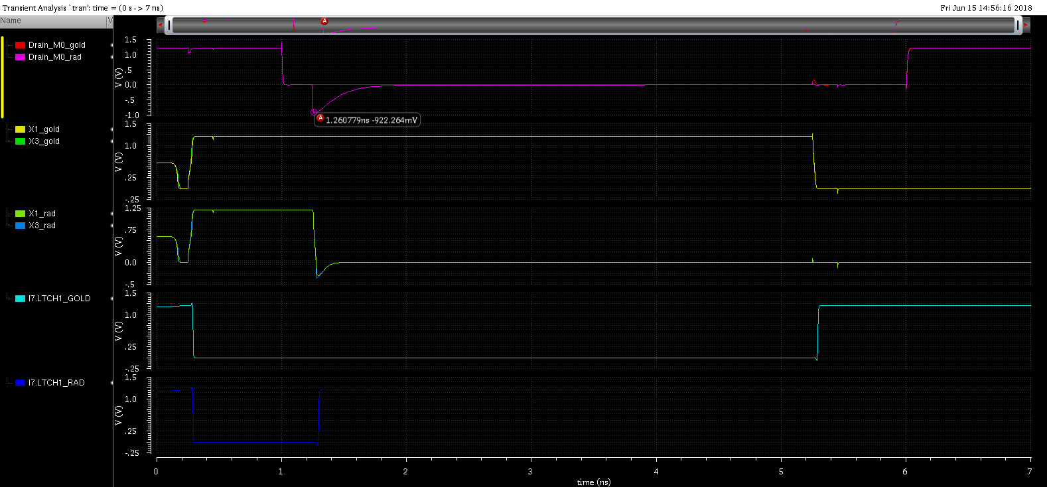
DICE structure analysis with AFTU
A single impact in transistor M0 affects nodes 1 & 3 of DICE latch → SEU (class III)
A SET (glitch) in LOAD line produces a cascade of bitflips!
AFTU predicts that SETs in the LOAD line produce a SEU cascade downstream

Slide 32
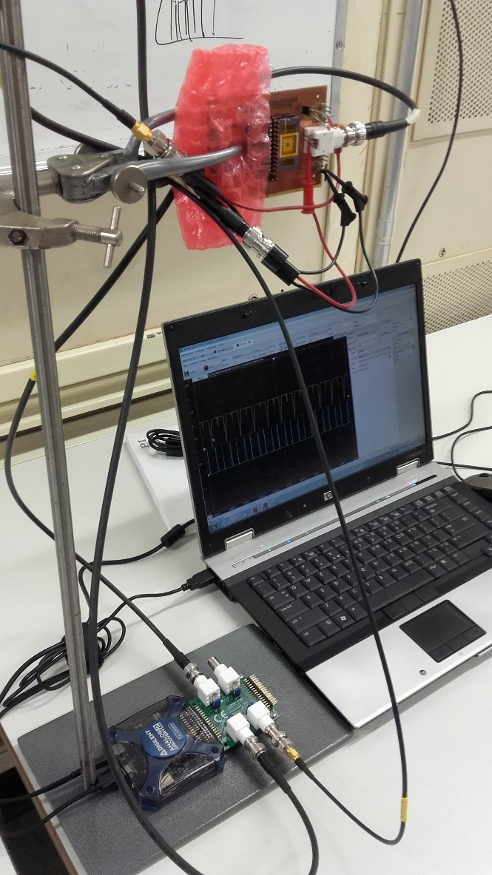
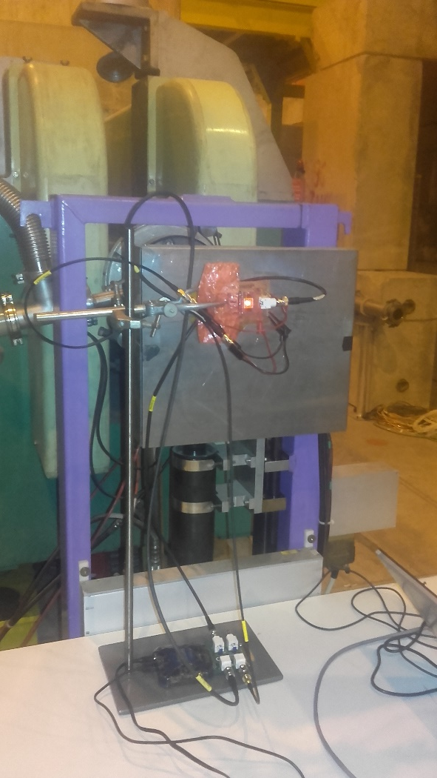
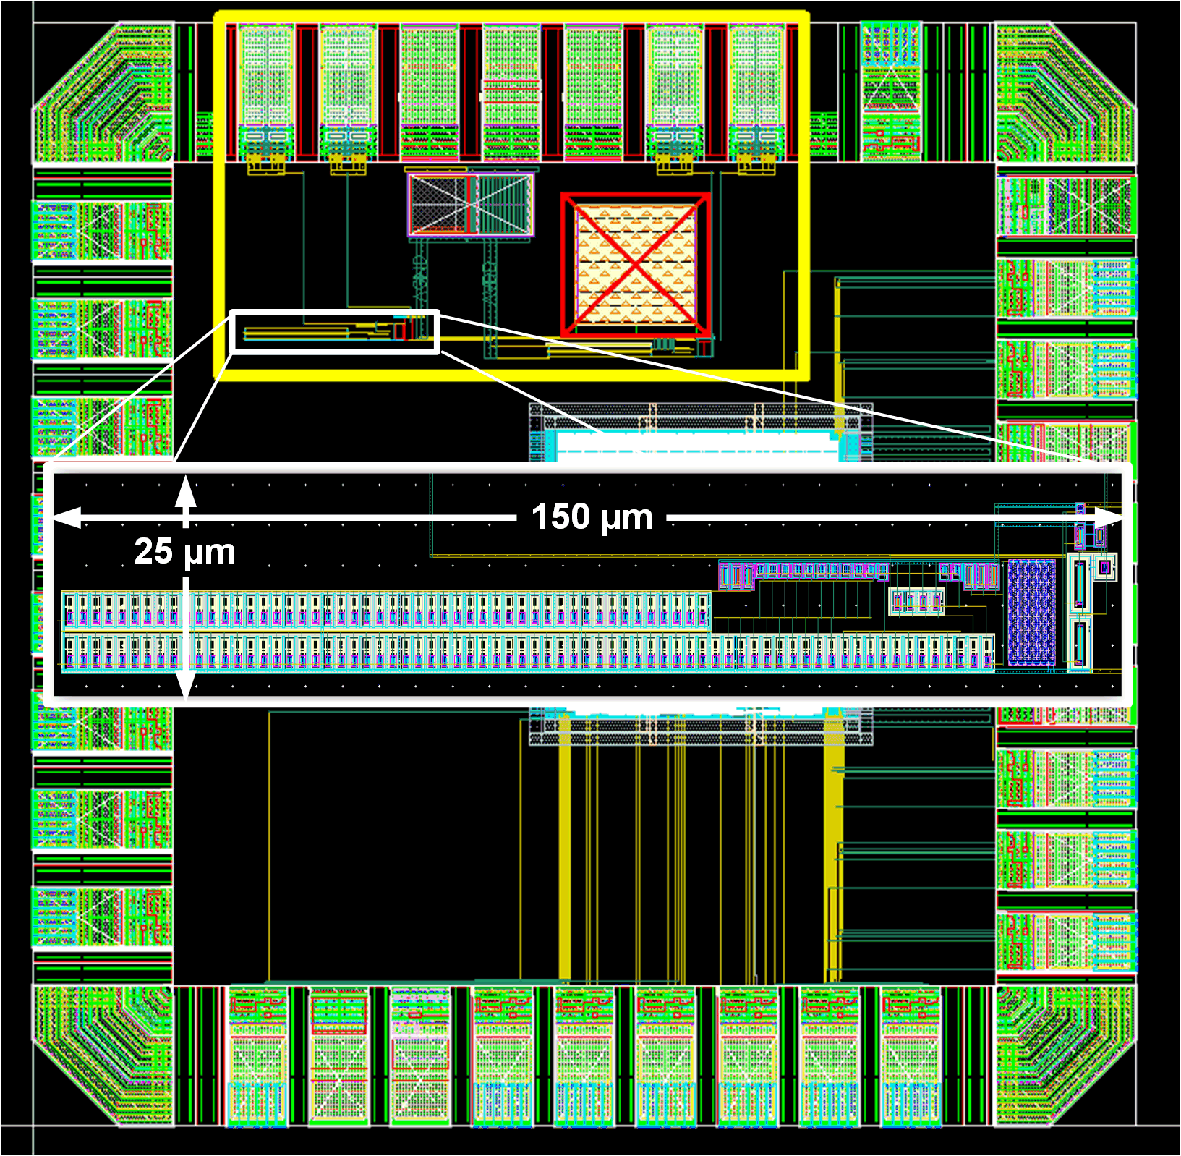
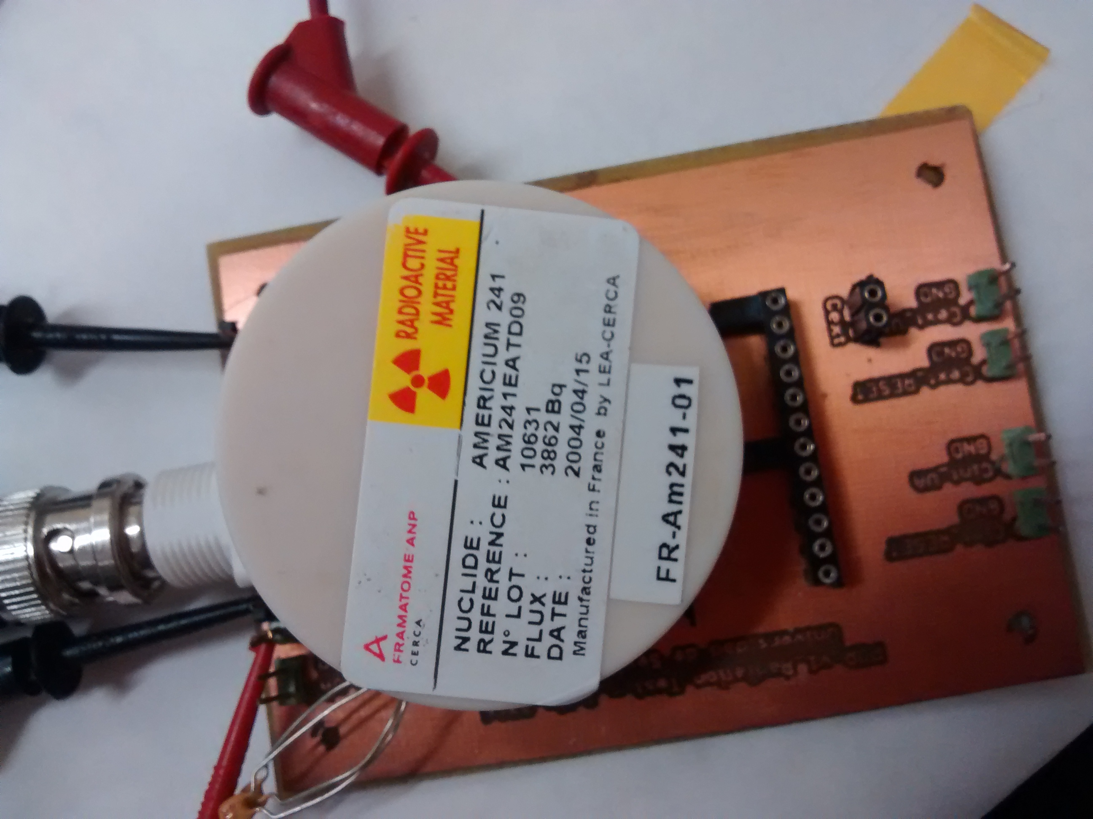
mini@sic for Radiation Testing (2016-17)
SEE Testing
1. Am214 alpha source (3850 Bq, 5.4 MeV, 2 weeks, 300K)
2. Real Environment :
SPS, CERN North Hall, Mixed proton-pion-neutron beam, 120 GeV, 5 days, 2e6 p/min, 300K
TID Testing:
RP-149 X rays Semiconductor Irradiation System (60kV)
~108 krad/min, 5 days, 300K
mini@sic layout. POR is inside the rectangle.
α source SET experiment
SPS SET experiment
@ CERN SPS

Slide 33
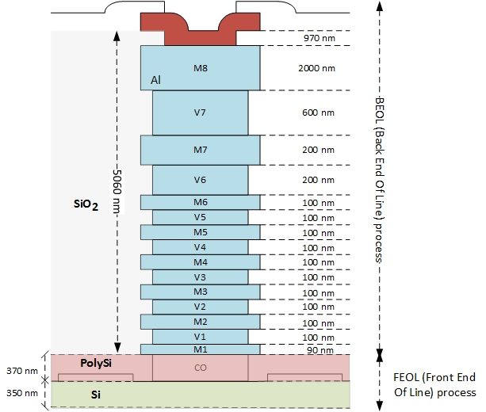
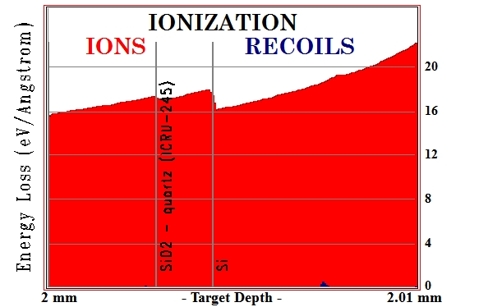
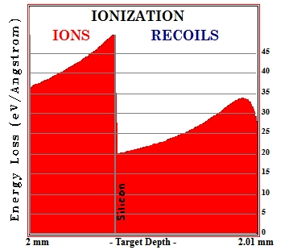
SEE Experiments:
July-August 2016 North Hall SPS CERN:
mixed proton+pion beam, 120 GeV, ~100 particles/s, 5 days, 300K, EMI contaminated environment
  NO SET OBSERVED (main result EMI pickupby the internal cap)
  We choose to discard the internal cap option
October 2016 alpha source
  (Am241, 3850Bq, 5.486 MeV, 300K), U.Sevilla dept of nuclear physics.
  SRIM LET ~0.8 MeV-cm²/mg:
    2mm Air+6μm Cu + 10μm Si (0.85 MeV-cm²/mg)
    2mm Air+6μm SiO₂+ 10μm Si (0.81 MeV-cm²/mg)
  NO SET OBSERVED
  Experiments show agreement with simulations
α particles

Slide 34
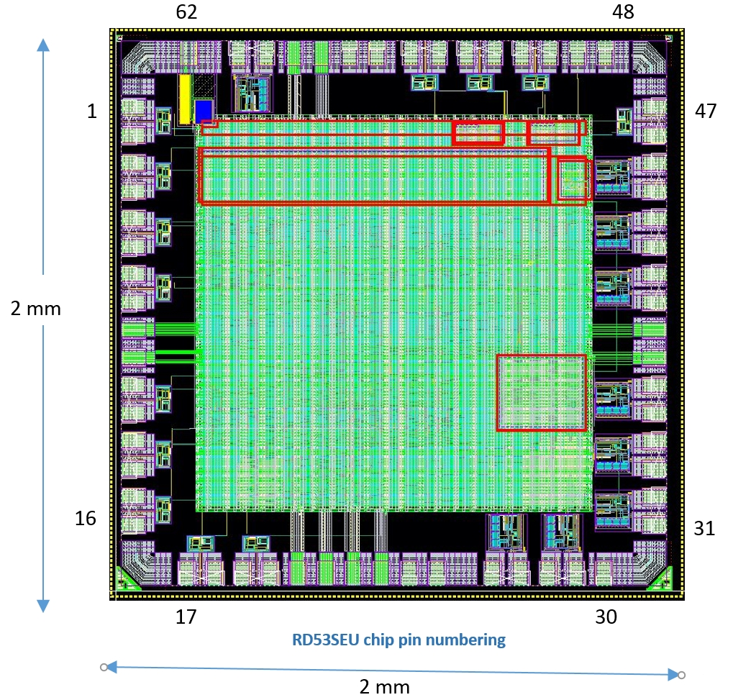
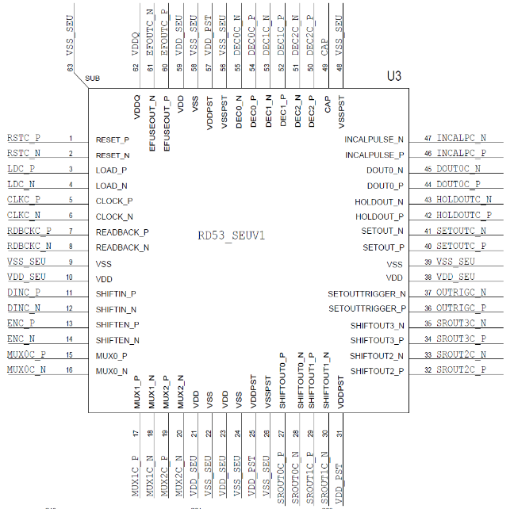
RD53SEU Chip Description
PARAMETER | VALUE
Die size (with seal-ring) | 2 mm x 2 mm
Pad Pitch | 100 um
PAD width | 63 um
PAD Height | 83 um
RD53SEU chip is a mini@sic
with the SEE resistant digital blocks, for RD53B readout chip*
NAME | # | DESCRIPTION
Shift Register based test structure | 1 | 1kb shift register of different flavours. Overall we have 19 such shift register based test structures.
DICE latch test structure | 2 | There are six flavours of DICE latch based test structures
Power On Reset test structure | 3 | Power on Reset block.
E-Fuse test structure | 4 | 32-bit e-fuse designed by the foundry.
SET pulse width measurements | 5 | Two different test structures are designed to measure the single event transients pulse width.
PoR and CMDRst | 6 | Fully functional Power On Reset and Command Reset Structures (SET analysis)
* RD53SEU chip is the result of a collaboration inside the general RD53 collaboration, comprised of people from Fermilab, CPPM, Bonn University and Sevilla University

Slide 35
SEE Testing System for RD53SEUChip
M.Barbero^{(1),} D.Fourgeron⁽¹⁾, R.Gaglione⁽²⁾, M.Menouni ^{(1),} CPPM (IN2P3 Marseille), LAPP (IN2P3 Annecy)

Slide 36
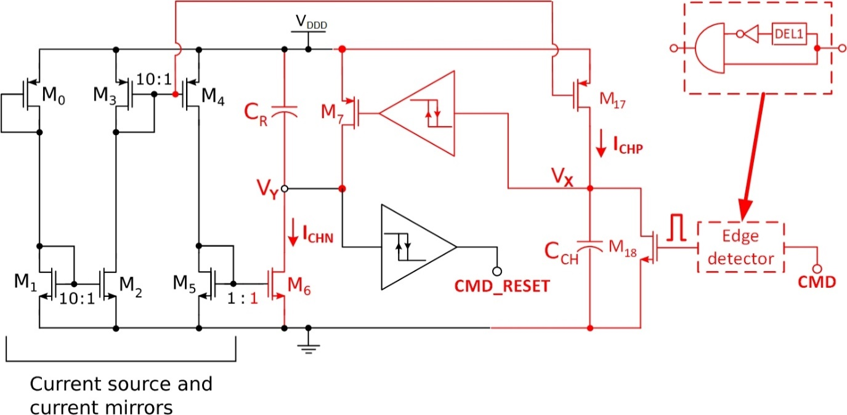
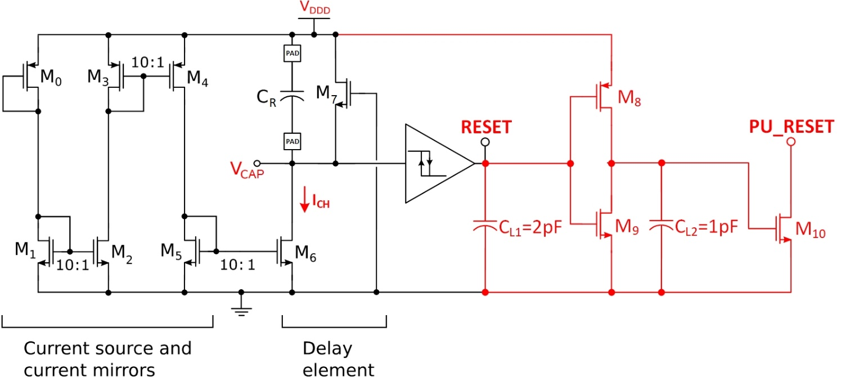
Target Coordinates SET
Command Reset IP Block
Power On Reset IP Block

Slide 37
Conclusions
Nanometric scales presents new challenges: they are more sensitive to SEE
Mixed-signal chips needs to put attention not only in SEU/SET but also in SEFI
Microprobe does not substitute Broadbeam testing but it is complementary, specially for mixed signal designs
Sensitivity maps are the tool to analyze highly complex mixed signal designs
Sensitivity maps by SEE simulation (schematics level) are the first tool
Sensitivity maps by experimental analysis (using Microprobes) are the second tool

Slide 38
Thanks for your attention
fpalomo@us.es

Slide 39
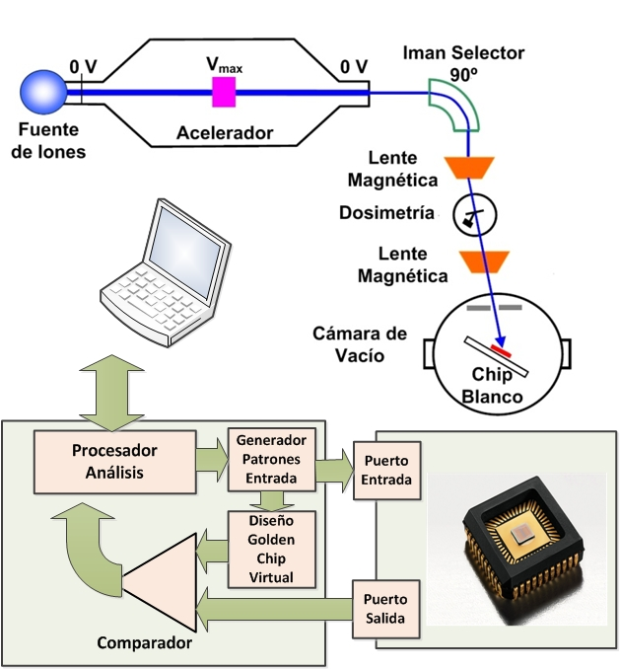
SEE Ion Experiments, Generic‏

Slide 40
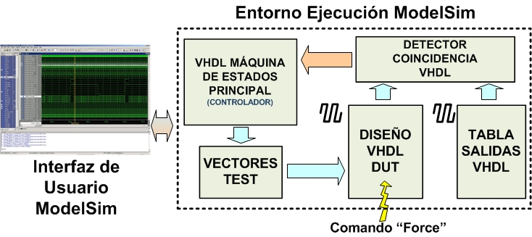
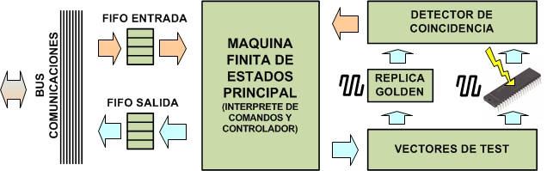
Test Monitor FTRad‏
FTSim
FTUsb
A low cost fault injection system for radiation environmental emulation. J.Nápoles, H.Guzmán-Miranda, J.M.Mogollón, F.R.Palomo, A.P.Vega-Leal, M.A.Aguirre, J.N.Tombs. Proceedings of DCIS 2007 Conference, Sevilla, Spain, 21st-23rd Dec. 2007.
A complete emulation system for single event analysis. J.Nápoles, H.Guzmán-Miranda, M.A.Aguirre, J.N.Tombs, J.M.Mogollón, F.R.Palomo, A.P.Vega-Leal. Proceedings of SPL 2008 Workshop, Bariloche, Argentina, 26th-28th, March 2008.

Slide 41
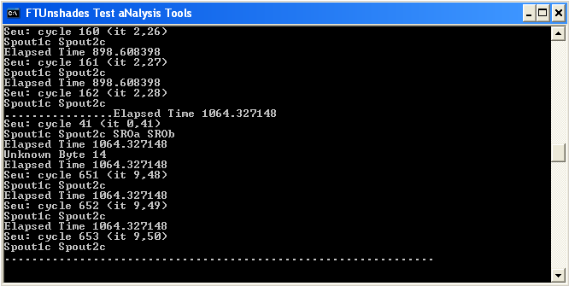
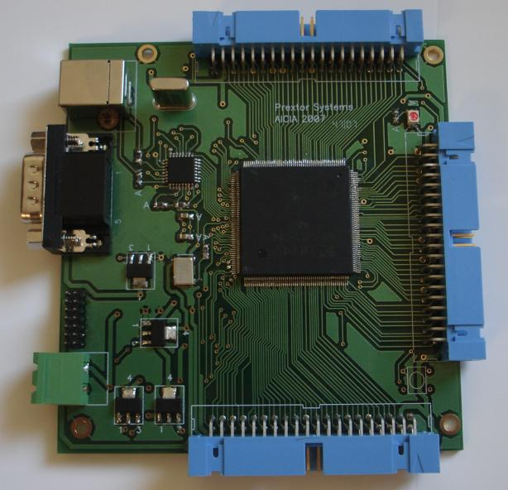
Test Monitor FTUsb‏
User
Commands
(Scripts)
Session.log
INPUT VECTOR DATABASE
Console
TNT
BITSTREAM
BIT ALLOCATION
Output pattern associated to a finite upset (bitflip)
in oposition to
a non-finite upset (synchronicity fault)

Slide 42
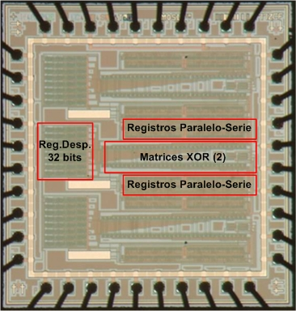
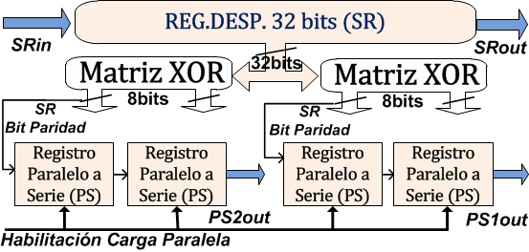
Test Chip JonIC (full observability)‏
ASIC F77H: TEST VEHICLE FOR SEE
0.6 μm VLSI Scale, AMSC5 process: Well Known
Kit CMOS, 2 metales, AMI 0.6u C5N (transistors) and AMI 1.6u ABN for I/O pads.
12.5 nm gate oxides, LOCOS process for field oxides.
Design for SEU testing plus a SET Detector.
Three designs in a chip, full custum in standard cells.

Slide 43



XOR matrix
32 input bits
2x8 output bits
If there is a bitflip in the input SR,
the XOR matrix generate a parity bit for the output PS registers.
Doubles as a SET target +
combinational chain for PIPB analysis
Shift Register
32 bits, 1 serial input, 1 serial output
32 parallel outputs to XOR matrices
Esentially a SEU detector
Parallel to Serial registers
8 input bits, 1 output bit
Interconnected by pairs
Esentially a pattern generator
Doubles as an aditional SEU detector
SET detector
32 input bits
2x8 output bits
Esentially a glitch detector
Doubles as a SET detector when
connected to the XOR matrix output

Slide 44
XOR matrix
32 input bits
2x8 output bits
If there is a bitflip in the input SR,
the XOR matrix generate a parity bit for the output PS registers.
Doubles as a SET target +
combinational chain for PIPB analysis
SET detector
32 input bits
2x8 output bits
Esentially a glitch detector
Doubles as a SET detector when
connected to the XOR matrix output

Slide 45





Pelletron Accelerator CNA‏
Tandem Pelletron NEC 9SDH2
Acceleration Voltage: 3 MV (E=3(1+q) MeV).
Ion species (nominal) from H to Au.
Kinetic Energy from 6 MeV (H¹⁺ ) to 39 MeV (Au¹²⁺).
Microprobe Endstation, (<50 cps, >10⁶ cps), <50x50 μm² ,
ESCC 25100: (100 iones/cm²-s, 10⁵ iones/cm²-s).

Slide 46


- Beam CEP “spot” ~ 3 μm²
Beam sweep, map scanning
Small target tray
Electron gun
- Two particle detectors (RBS, STIM)
A secondary electrons detector (SEI)
A X ray detector (SiLi)
A γ ray detector (HPGe, NaI)
Notes:
Explicar qué es una microsonda

Slide 47






Facility Posibilities (Microbeam Line EndStation)‏

Slide 48

Facility Posibilities (Microbeam Line EndStation)‏

Slide 49

Facility Posibilities (Microbeam Line EndStation)‏

Slide 50

Facility Posibilities (Microbeam Line EndStation)‏

Slide 51

Facility Posibilities (Microbeam Line EndStation)‏

Slide 52



NIEL Simulations
For low energy ions, NIEL
calculus is mandatory:
-The ion stops in the target
-Low energy means low
penetration depth so vacancies can diffuse to the active volumes
SRIM simple calculus
-Simulation obtains #vacancies
-Kinchin-Pease hypothesis:
ρ:Si density
n_{d}(z): lineal vacancy rate (#/cm) by direct hit & recoil
M: energy per vacancy creation event
Td: vacancy energy threshold (21 eV in Si)
The Simulation of Damage Tracks in Silicon. S.R.Messenger et al, IEEE Transactions on Nuclear Science, 51(5):2846-2850, 2004.
Nonionizing Energy Loss (NIEL) for Heavy Ions, S.R.Messenger et al., IEEE Transactions on Nuclear Science , 46(6):1595-1602, 1999.

Slide 53




TID & DDD experiment design study
Mandatory low fluence for CNA Tandem ions:
High LET High TID in the active zone (field oxides).
Increasing NIEL Low depth Displacement Damage.
Minimum fluence Φ for SEU?: every microscopic sensitive area, A_{sen}, must receive 1 LET_{umb} hit.
In active volume (hasta 3 μm)
DDD ~ 1E-3 TID
At low depth (10 μm)
DDD dominant
Precise Fluence and microscopic aim: MICROPROBE
~ 0 MeV-cm²/mg
~ 12 E-3 MeV-cm²/mg
~ 0.45 MeV-cm²/mg
~ 7 MeV-cm²/mg

Slide 54

TID & DDD experiment design study
Mandatory low fluence for CNA Tandem ions:
High LET High TID in the active zone (field oxides).
Increasing NIEL Low depth Displacement Damage.
Minimum fluence Φ for SEU?: every microscopic sensitive area, A_{sen}, must receive 1 LET_{umb} hit.
In active volume (hasta 3 μm)
DDD ~ 1E-3 TID
At low depth (10 μm)
DDD dominant
Precise Fluence and microscopic aim: MICROPROBE
~ 20 E-3 MeV-cm²/mg
~ 0.45 MeV-cm²/mg
~ 0 MeV-cm²/mg
~ 12 E-3 MeV-cm²/mg
~ 0.45 MeV-cm²/mg
~ 7 MeV-cm²/mg

Slide 55




Threshold LET experiment
ION PELLETRON
TNT
CONTROL
SOFTWARE
COMMANDS
ION BEAM
LOG
TESTVECTORS
TEST MONITOR
FTUsb
OUTPUTS
TARGET CHIP
IN MICROCHAMBER
TARGET CHIP
-Oxígen Ions
-Shift Register:239x282 μm²
-Static Experiment
- ~200 cps, 2.7Φ_{cob}, 300 s
- 2 different chips
-Flux Stability Control by PIXE
Typical Sensitive Area: Drain 3 μm²
Maximum TID per chip ~20 krad

Slide 56

Threshold LET experiment
-Oxígen Ions
-Shift Register:239x282 μm²
-Static Experiment
- ~200 cps, 2.7Φ_{cob}, 300 s
- 2 different chips
-Flux Stability Control by PIXE
Typical Sensitive Area: Drain 3 μm²
Maximum TID per chip ~20 krad

Slide 57

Threshold LET experiment
Typical Sensitive Area: Drain 3 μm²
Maximum TID per chip ~20 krad

Slide 58
Dynamic SEU Experiments
# SR0c #
# Elapsed FPGA Cycles 0x099a73f46f
# Seu: cycle 1058 (it 15,53)
# Spout1c # Spout2c #
# Elapsed FPGA Cycles 0x099a73f4a7
# Seu: cycle 1059 (it 15,54)
# Spout1c # Spout2c #
# Elapsed FPGA Cycles 0x099a73f4e4
# Seu: cycle 1065 (it 15,60)
# Spout1c # Spout2c #
# Elapsed FPGA Cycles 0x099a73f517
# Seu: cycle 1066 (it 15,61)
# Spout1c # Spout2c #
# Elapsed FPGA Cycles 0x099a73f54f
# Seu: cycle 1067 (it 15,62)
Experimental
Output Pattern
Selección de Patrones de SEU
por retrosimulación lógica
Simulation Logic Chronogram associated to a SEU output: SEU identified
Dynamic Experiments (CLK enabled), oxygen ions 18 MeV
Core F77H irradiation (1100x580 μm²), 4600 cps, 4 min, ~2 #/μm²
Ionization Dose-Rate: 4.6 krad/min
Experimental SEU Dynamical patterns matched
No observation of SET2SEU patterns
Early works on the nuclear microprobe fine tuning for microelectronics irradiation tests at CEICI (Sevilla, Spain). F.R.Palomo, Y.Morilla, J.M.Mogollón, J.García-López, J.Labrador, M.A.Aguirre. Nuclear Instruments and Methods in Physics Research B, 269(20):2210-2216, 2011.
Early works on the nuclear microprobe fine tuning for microelectronics irradiation tests at CEICI (Sevilla, Spain). Bringing about single event effects in digital ASIC’s. F.R.Palomo, Y.Morilla, J.M.Mogollón, J.García-López, J.Labrador, M.A.Aguirre. Proceedings of ICNMTA (International Conference on Nuclear Microprobe Technology and Applications) 2010 Conference, Leipzig, Germany, 26th-30th July , 2010.

Slide 59

Dynamic SEU Experiments
# SR0c #
# Elapsed FPGA Cycles 0x099a73f46f
# Seu: cycle 1058 (it 15,53)
# Spout1c # Spout2c #
# Elapsed FPGA Cycles 0x099a73f4a7
# Seu: cycle 1059 (it 15,54)
# Spout1c # Spout2c #
# Elapsed FPGA Cycles 0x099a73f4e4
# Seu: cycle 1065 (it 15,60)
# Spout1c # Spout2c #
# Elapsed FPGA Cycles 0x099a73f517
# Seu: cycle 1066 (it 15,61)
# Spout1c # Spout2c #
# Elapsed FPGA Cycles 0x099a73f54f
# Seu: cycle 1067 (it 15,62)
Experimental
Output Pattern
Selección de Patrones de SEU
por retrosimulación lógica
Simulation Logic Chronogram associated to a SEU output: SEU identified
Dynamic Experiments (CLK enabled), oxygen ions 18 MeV
Core F77H irradiation (1100x580 μm²), 4600 cps, 4 min, ~2 #/μm²
Ionization Dose-Rate: 4.6 krad/min
Experimental SEU Dynamical patterns matched
No observation of SET2SEU patterns
Early works on the nuclear microprobe fine tuning for microelectronics irradiation tests at CEICI (Sevilla, Spain). F.R.Palomo, Y.Morilla, J.M.Mogollón, J.García-López, J.Labrador, M.A.Aguirre. Nuclear Instruments and Methods in Physics Research B, 269(20):2210-2216, 2011.
Early works on the nuclear microprobe fine tuning for microelectronics irradiation tests at CEICI (Sevilla, Spain). Bringing about single event effects in digital ASIC’s. F.R.Palomo, Y.Morilla, J.M.Mogollón, J.García-López, J.Labrador, M.A.Aguirre. Proceedings of ICNMTA (International Conference on Nuclear Microprobe Technology and Applications) 2010 Conference, Leipzig, Germany, 26th-30th July , 2010.

Slide 60

AFTU ToolChain
Before using AFTU:
The user designs a circuit with Cadence as usual.
The design is simulated through a testbench.
Of all files generated by Cadence, we pick the netlist.

Slide 61

AFTU instrumentalize
The instrumentalizer implements a parser for the SPECTRE language
Replaces the netlist with a functionally identical one allowing SEE emulation.
netlist.nodes lists all observable circuit nodes.
netlist.sources lists all transistors where an impact can be emulated.

Slide 62

AFTU ocean init
AFTU projects are flexible and give the user many options for analysis.
config contains paths, times, heuristics parameters, initial values…
watch defines all elements in the circuit to be observed during the simulation
inject defines where, when and how much charge we inject (SEE emulation).

Slide 63

AFTU Ocean cook
From all this data an Ocean simulation script is produced
Includes all paths and required data.
Describes the way to perform the user defined test campaign.
Defines how to analyze the results of the campaign.

Slide 64

AFTU campaign
Cadence runs the provided script.
It produces a CSV file with the desired statistics.
This uncovers radiation vulnerabilities in the circuit.

Slide 65
A Practical Example
Let's say we have this circuit:
What is the critical charge to produce a SEU?

Slide 66


Netlist
D-latch transient testbench and schematic
view of the digital cell
STMicroelectronics 130 nm

Slide 67

Watch & Inject
watch Q = /Q :
threshold = 0.975 ;
inject I0_MP19:
Q = .025p, .05p, 0.1p, .2p, .5p, .75p, 1p, 1.5p;
t = 1.0n, 1.1n, 1.2n, 1.3n, 1.4n, 1.5n, 1.6n, 1.7n, 1.8n, 1.9n;
inject I0_MN19:
Q = .025p, .05p, 0.1p, .2p, .5p, .75p, 1p, 1.5p;
t = 1.0n, 1.1n, 1.2n, 1.3n, 1.4n, 1.5n, 1.6n, 1.7n, 1.8n, 1.9n;
inject I0_MP18:
Q = .025p, .05p, 0.1p, .2p, .5p, .75p, 1p, 1.5p;
t = 1.0n, 1.1n, 1.2n, 1.3n, 1.4n, 1.5n, 1.6n, 1.7n, 1.8n, 1.9n;

Slide 68

Results
Output ImpactNode Qinj Timp Trec Vmax
V_Q I0_MP18 2.5e-14 1e-09 0.000000 0.001941
V_Q I0_MP18 2.5e-14 1.1e-09 0.000000 0.00219
V_Q I0_MP18 2.5e-14 1.9e-09 0.000000 0.003664
V_Q I0_MP18 5e-14 1e-09 2.000000 1.807421
V_Q I0_MP18 5e-14 1.1e-09 1.910000 1.807422
V_Q I0_MP18 5e-14 1.2e-09 1.800000 1.807426
V_Q I0_MP18 5e-14 1.3e-09 1.700000 1.807384
V_Q I0_MP18 5e-14 1.8e-09 0.000000 0.519730
V_Q I0_MP18 5e-14 1.9e-09 1.100000 1.803023
Output ImpactNode Qinj Timp Trec Vmax
V_Q I0_MN11 2.5e-14 1e-09 0.000000 0.006827
V_Q I0_MN11 2.5e-14 1.9e-09 0.000000 0.016568
V_Q I0_MN11 5e-14 1e-09 0.000000 0.017084
V_Q I0_MN11 5e-14 1.3e-09 0.000000 0.005371
V_Q I0_MN11 5e-14 1.4e-09 1.610000 1.806680
V_Q I0_MN11 5e-14 1.5e-09 1.500000 1.806814
V_Q I0_MN11 5e-14 1.6e-09 1.400000 1.805740
V_Q I0_MN11 5e-14 1.7e-09 1.300000 1.802925
V_Q I0_MN11 5e-14 1.8e-09 0.240000 1.404223
“Deviation Recovery” heuristic analysis

Slide 69

Results
D-latch circuit , STMicroelectronics 130 nm
For this particular test, we shot at 10 different instants per period to obtain a sensitivity percentage: for example if 7 impacts generate a SEU we have a sensitivity of 70%
Notes:
For this particular test, we shot at 10 different instants per period to obtain a percentage: for example if 7 impacts generate a SEU we have a sensitivity of 70%

